Slide 1
The Meteorology of Tornado Forecasting: Ingredients - Moisture
Rich Thompson
SPC

Slide 2
Workshop Organization
Observations, convective processes, and synoptic processes:
How to read weather maps and sounding diagrams
“Q-G Theory”, jet streaks, fronts, cyclones
Severe thunderstorm ingredients:
Moisture and lapse rate sources
Severe thunderstorm ingredients:
Lift and vertical wind shear sources
Supercell and tornado conceptual models
Reasons behind parameter development

Slide 3
Low-Level Moisture and Return Flow Cycle
Key elements:
Air mass modification over warmer water
Return flow trajectories

Slide 4
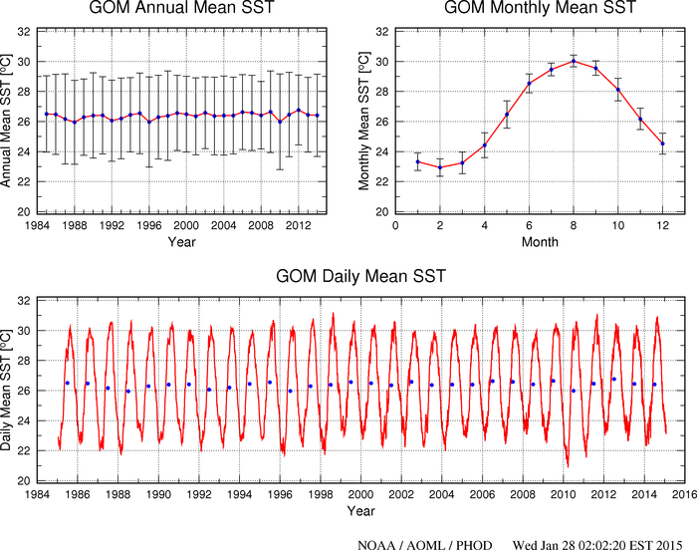

Slide 5
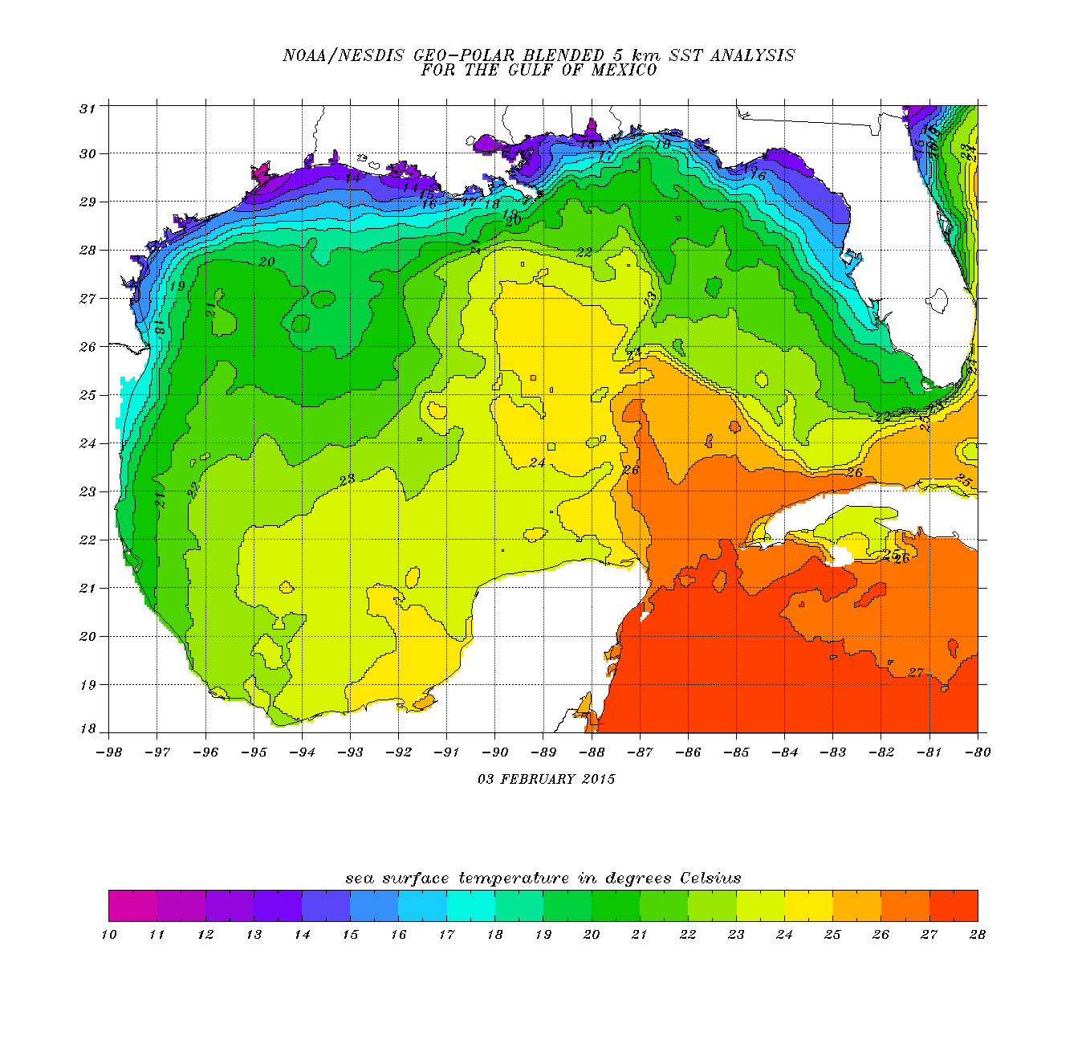
69
67
63
71
65
73

Slide 6
Fall Return Flow Case
Tallahassee
Lake Charles
Brownsville
Cancun
Veracruz

Slide 7
Cancun

Slide 8
Veracruz

Slide 9
BRO

Slide 10
LCH

Slide 11
TLH

Slide 12
Day 2

Slide 13
Cancun

Slide 14
Veracruz

Slide 15
BRO

Slide 16
LCH

Slide 17
TLH

Slide 18
Day 3

Slide 19
Cancun

Slide 20
Veracruz

Slide 21
BRO

Slide 22
LCH

Slide 23
TLH

Slide 24
Day 4

Slide 25
Cancun

Slide 26
Veracruz

Slide 27
BRO

Slide 28
LCH

Slide 29
TLH

Slide 30
Day 5

Slide 31
Veracruz

Slide 32
BRO

Slide 33
LCH

Slide 34
TLH

Slide 35
Day 6

Slide 36
Changes at BRO over 5 days

Slide 37
BRO day 1

Slide 38
BRO day 2

Slide 39
BRO day 3

Slide 40
BRO day 4

Slide 41
BRO day 5

Slide 42
What sort of air mass modification would you expect?
Air T = 65-70 F
SST = 72-74

Slide 43
14 April 2012 Return Flow Case

Slide 44
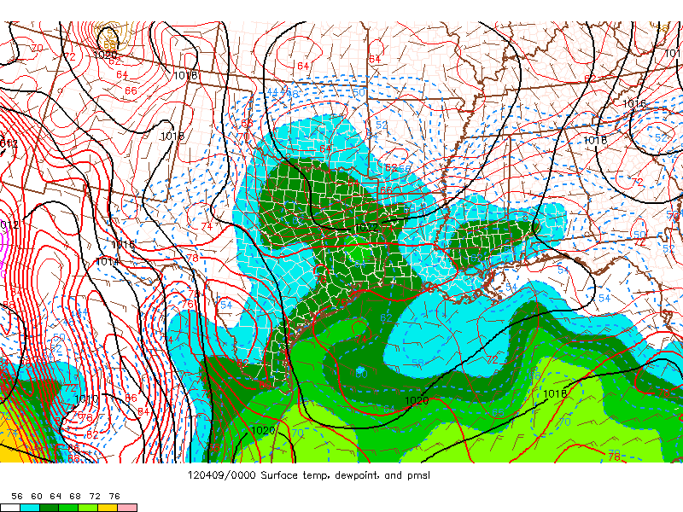
Day 1

Slide 45
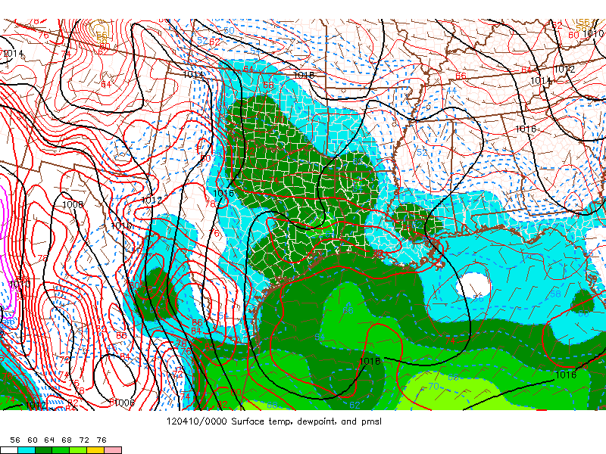
Day 2

Slide 46
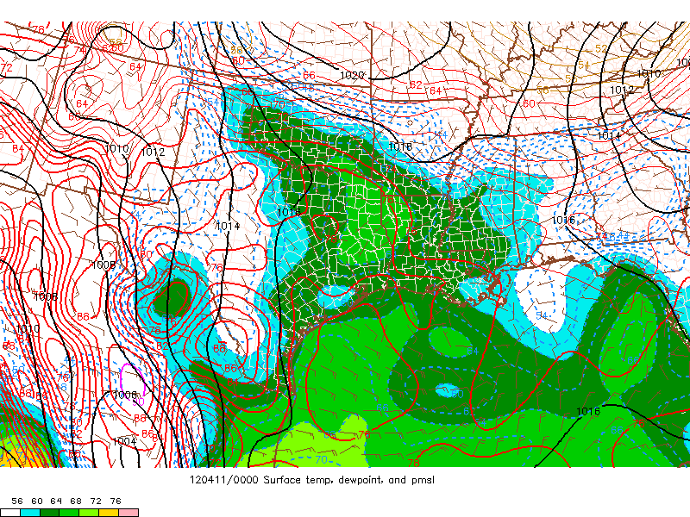
Day 3

Slide 47
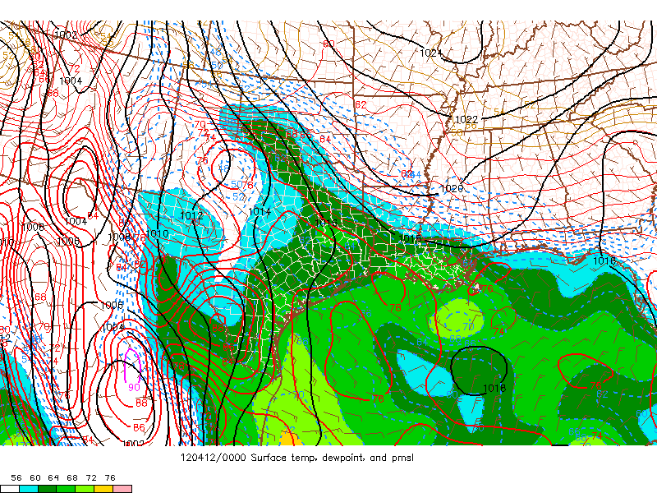
Day 4

Slide 48
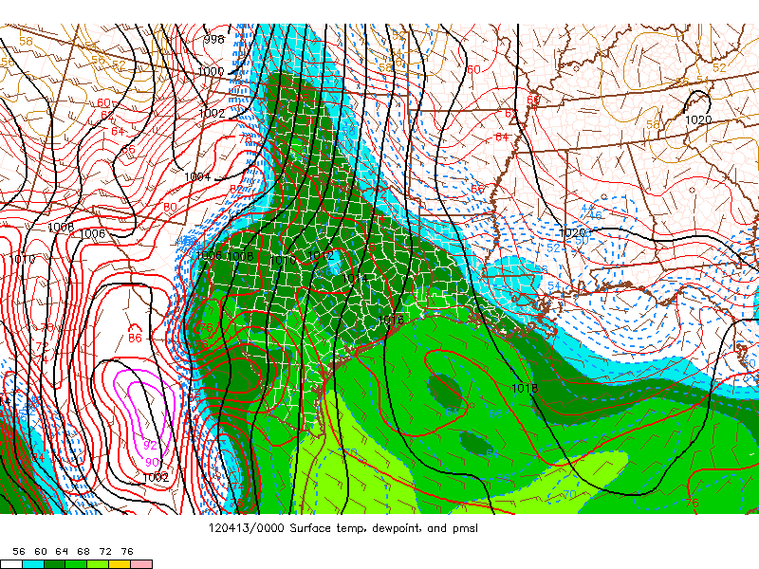
Day 5

Slide 49
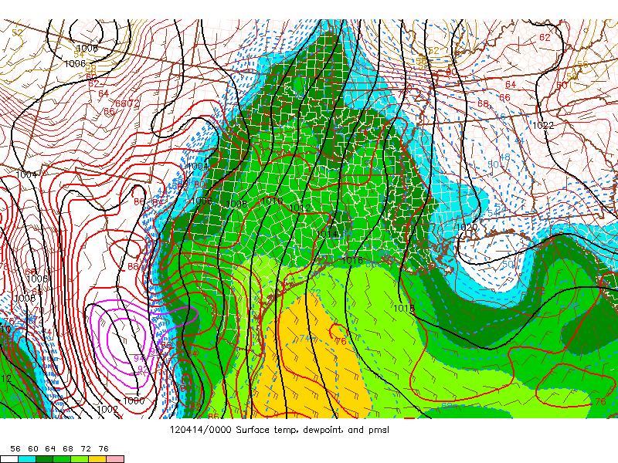
Day 6

Slide 50
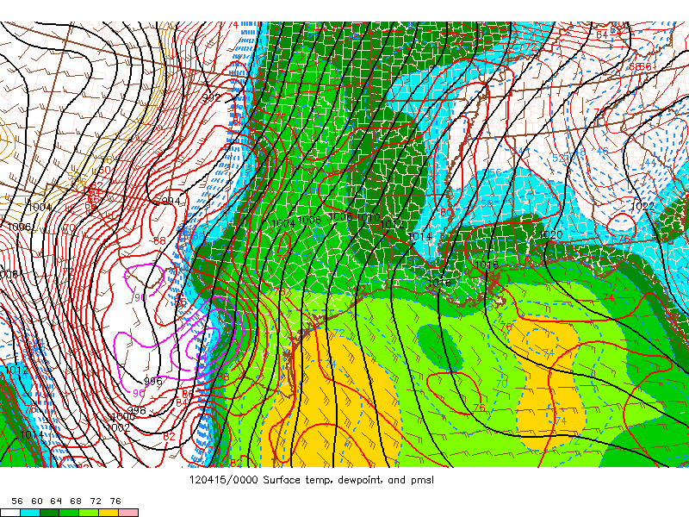
Day 7

Slide 51
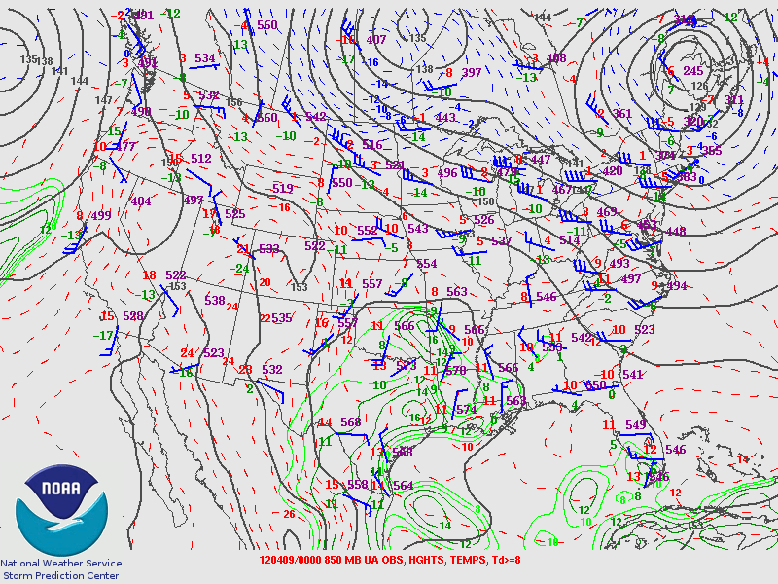
Day 1

Slide 52
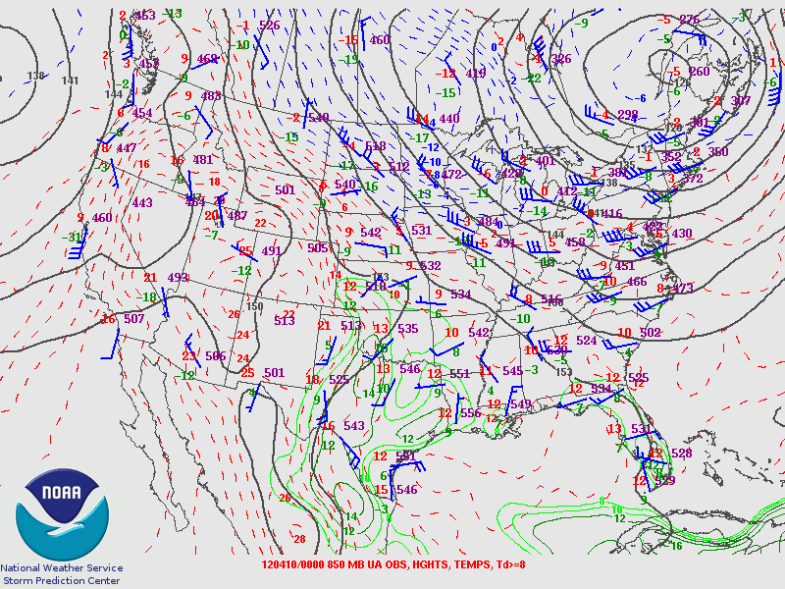
Day 2

Slide 53
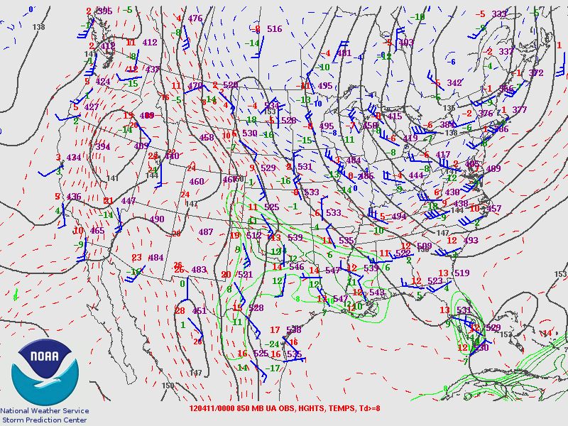
Day 3

Slide 54
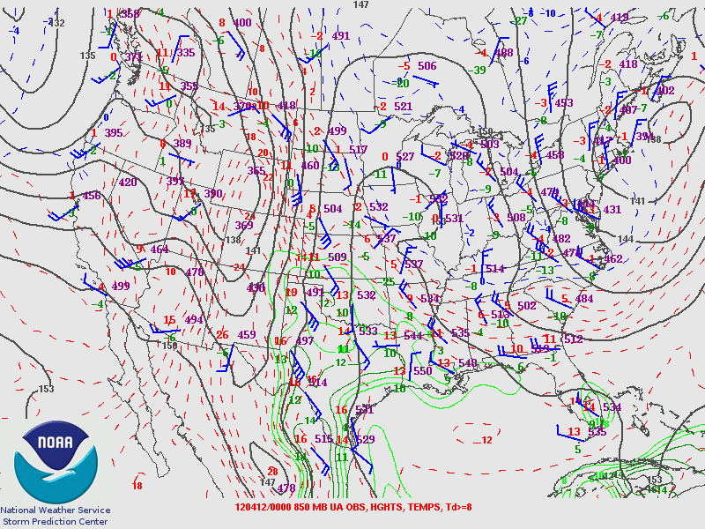
Day 4

Slide 55
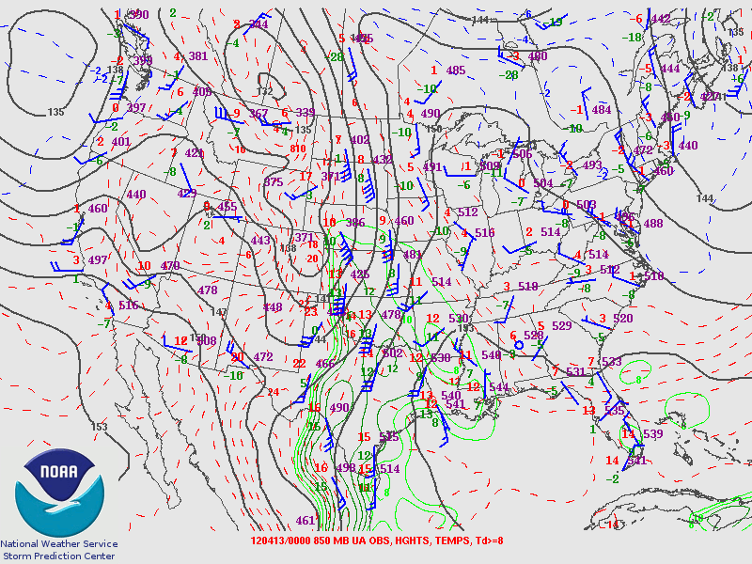
Day 5

Slide 56
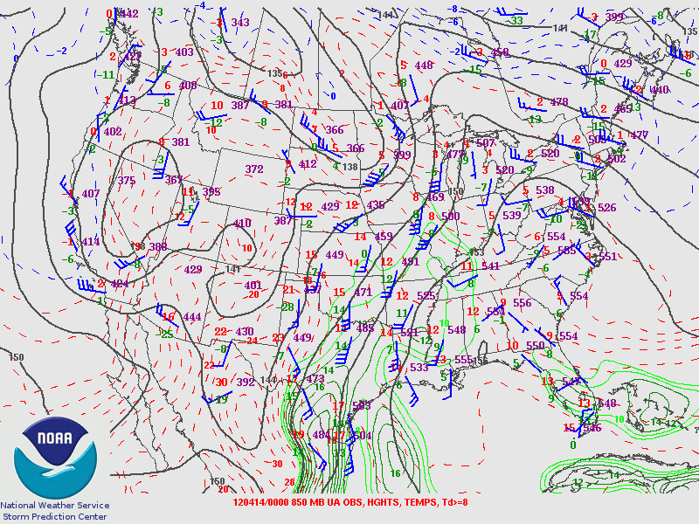
Day 6

Slide 57
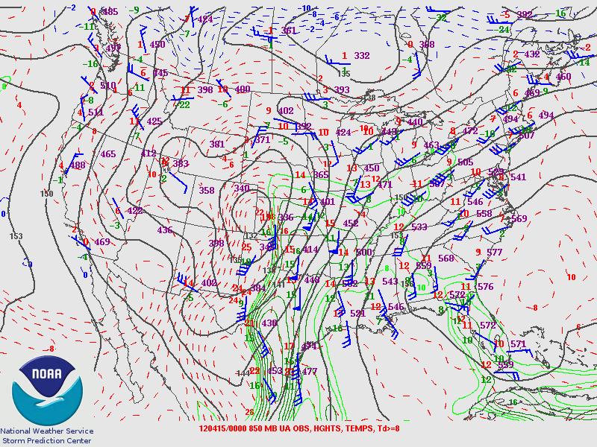
Day 7

Slide 58
CRP day 1

Slide 59
CRP day 2

Slide 60
CRP day 3

Slide 61
CRP day 4

Slide 62
CRP day 5

Slide 63
CRP day 6

Slide 64
CRP day 7

Slide 65
Impacts of Inland Vertical Mixing
Surface moisture can decrease during the day when:
Daytime heating/mixing extends deeper than original moist layer depth
Moisture advection is not enough to offset mixing
Usually dry soil, little green vegetation, and ongoing drought

Slide 66
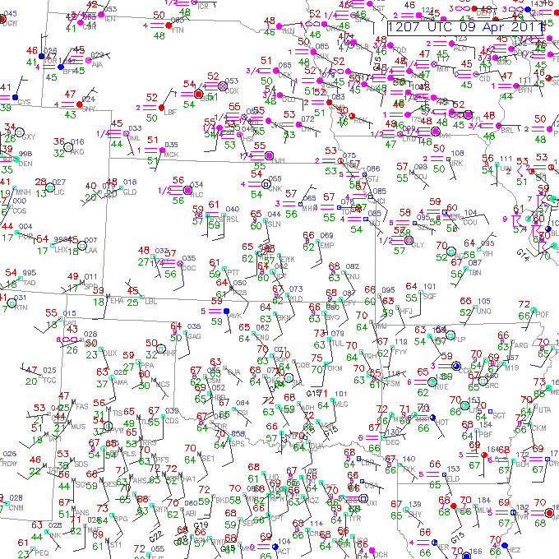
60 F
64 F

Slide 67
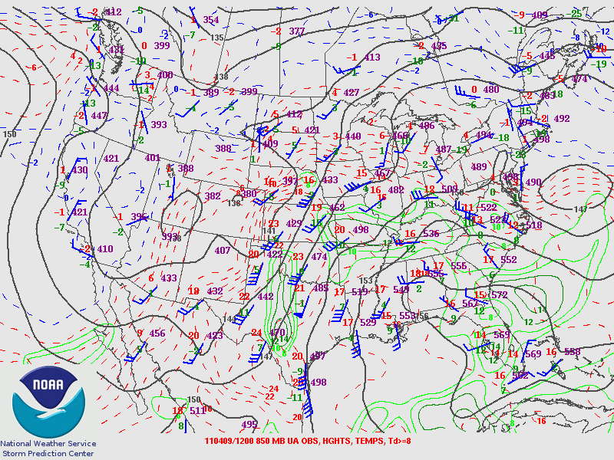

Slide 68
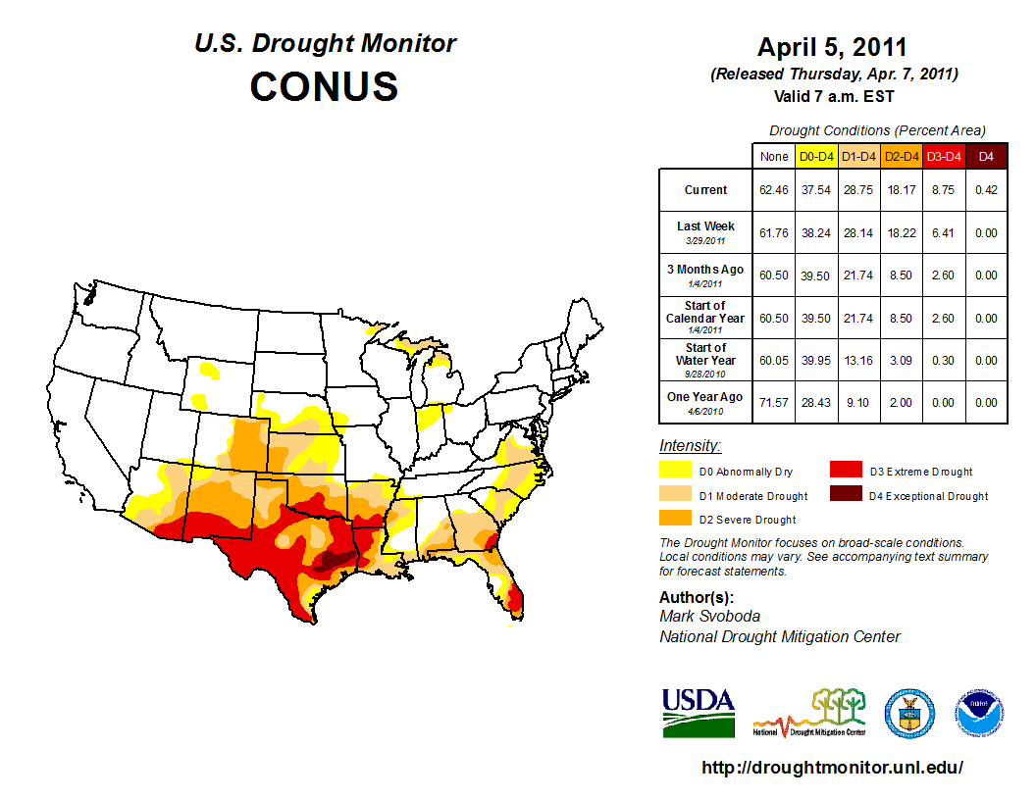

Slide 69
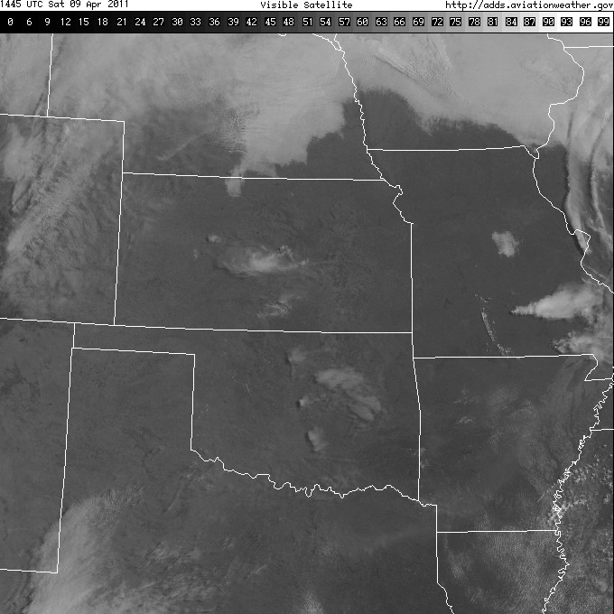
OAX
TOP
LMN
OUN
FWD

Slide 70
Diurnal changes in moisture
How deep will mixing extend during afternoon?
What is the character of upstream moisture?
What about soil moisture and vegetation?
Start with OUN, then look at LMN and OAX.

Slide 71
Upstream from OUN
morning
FWD

Slide 72
morning
OUN

Slide 73
evening
OUN

Slide 74
Upstream from LMN
morning
OUN

Slide 75
morning
LMN

Slide 76
afternoon
LMN

Slide 77
evening
LMN

Slide 78
Upstream from OAX
morning
TOP

Slide 79
morning
OAX

Slide 80
evening
OAX

Slide 81
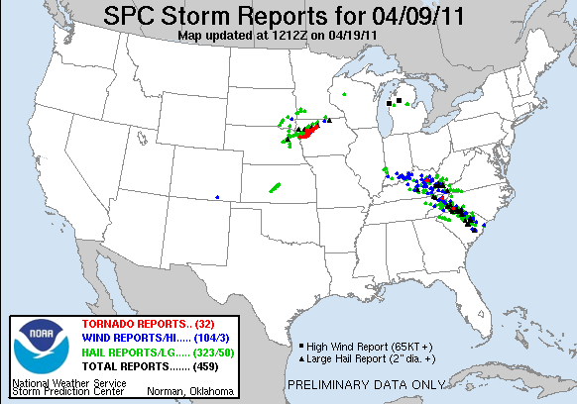

Slide 82
Evapotranspiration in warm season
Need moist soil and growing vegetation
Plentiful rain previous 1-2 weeks
Maturing crops (wheat, corn, or canola)
Capped boundary layer to trap moisture
Almost always a significant return flow contribution!

Slide 86
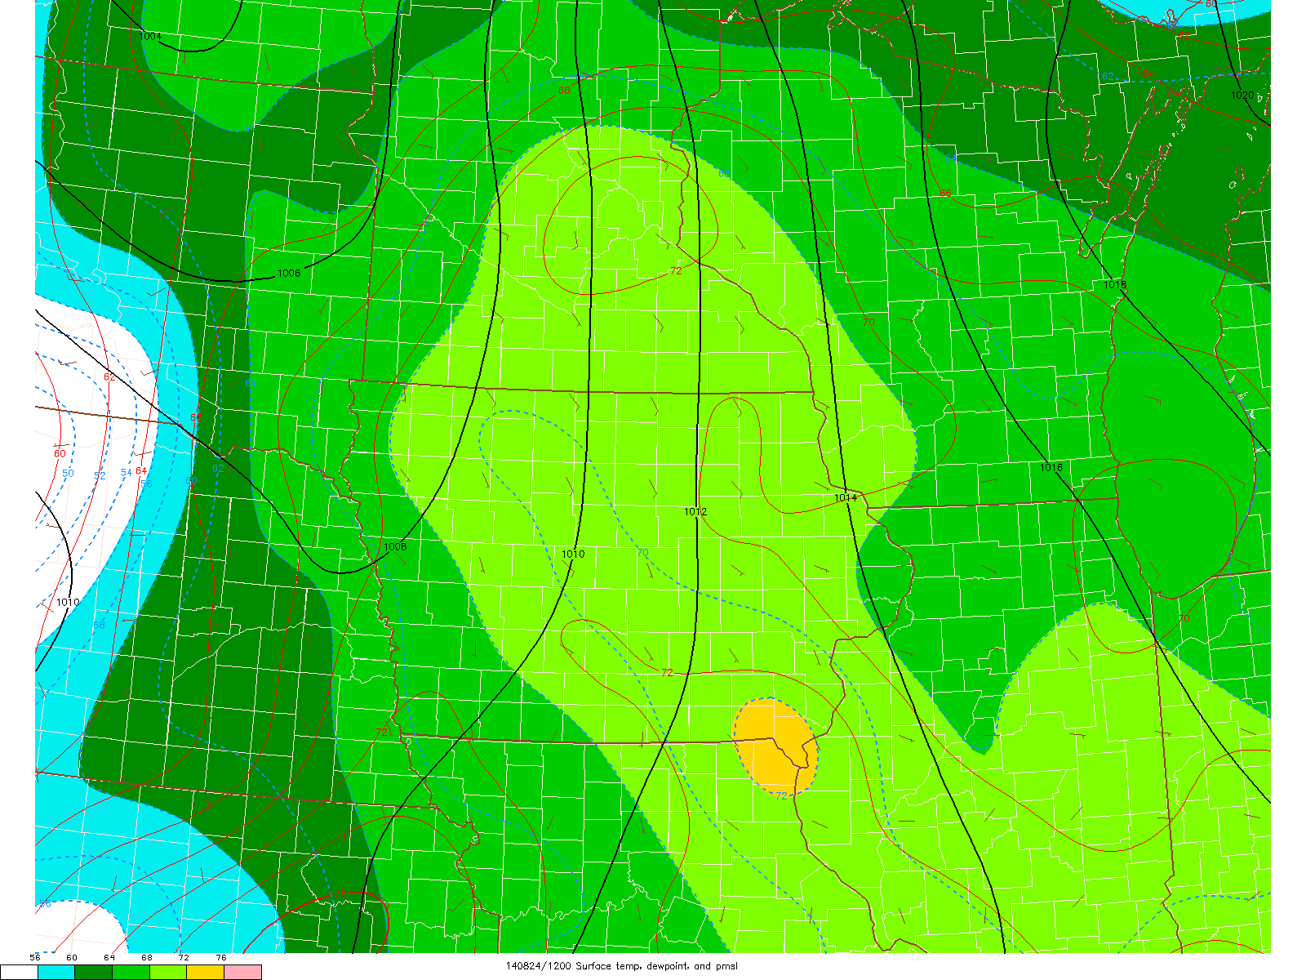
Evolution of moisture during the day

Slide 87
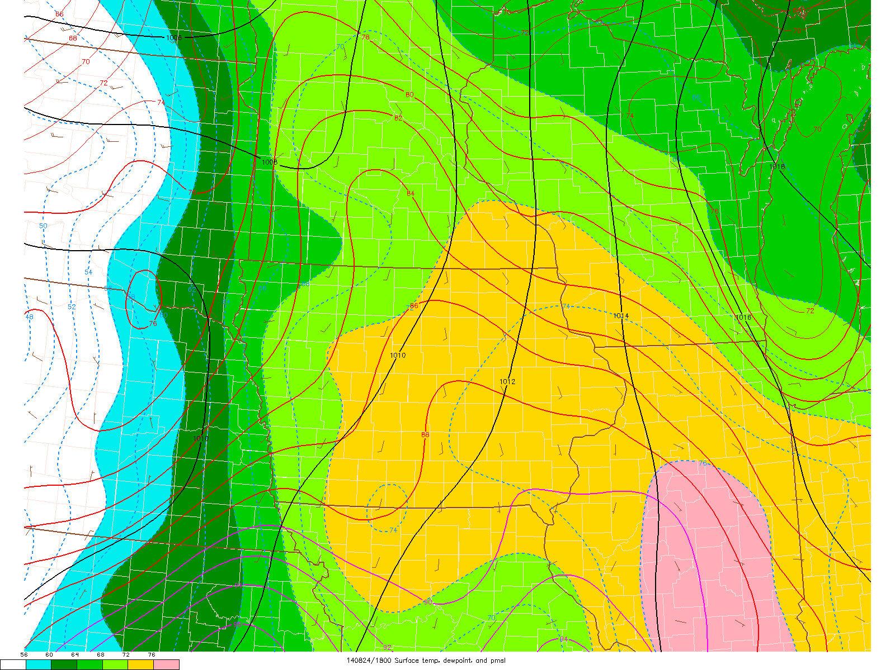

Slide 88
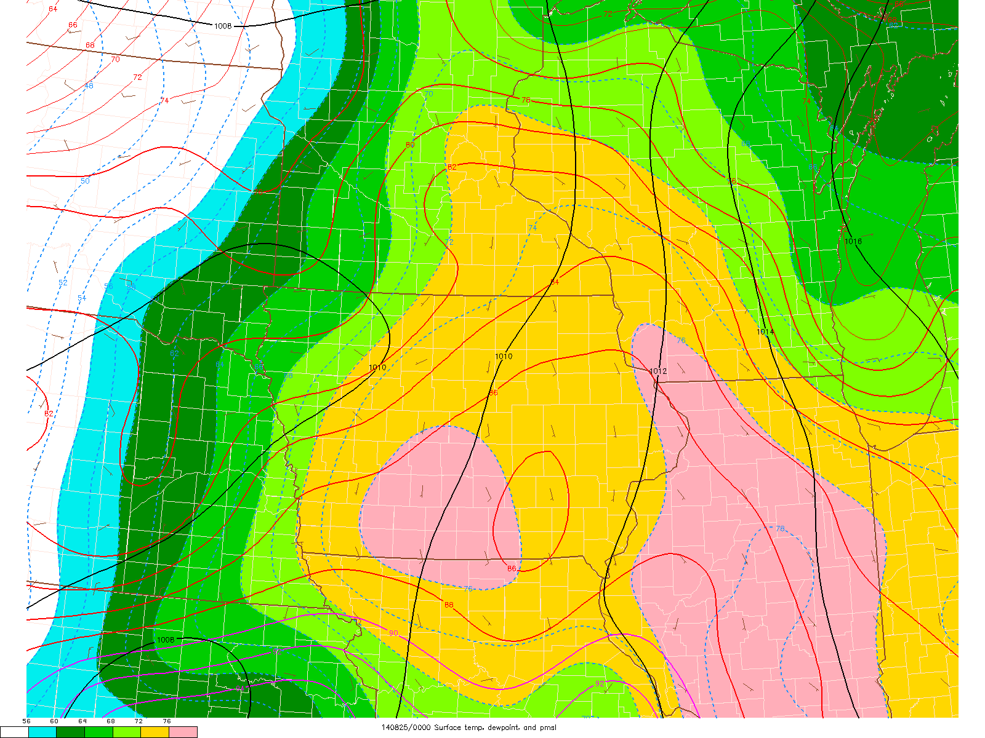

Slide 89
morning
DVN

Slide 90
evening
DVN

Slide 91
morning
ILX

Slide 92
evening
ILX

Slide 93
Pattern leading up to “evapotranspiration” moisture?

Slide 94
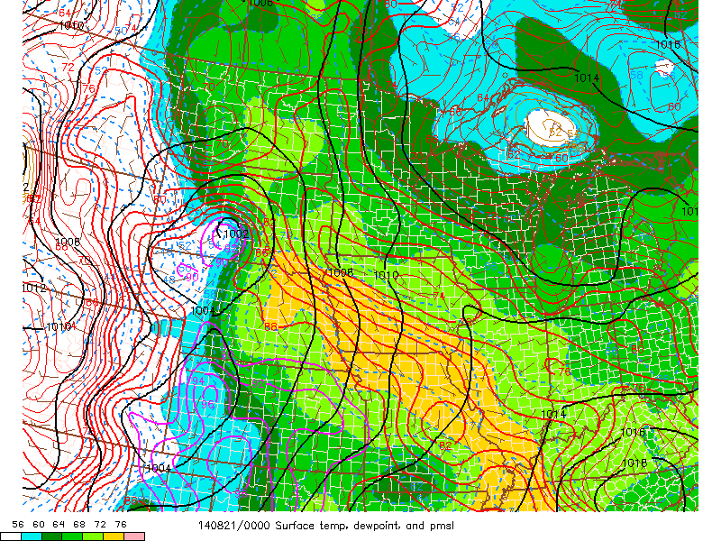
L

Slide 95
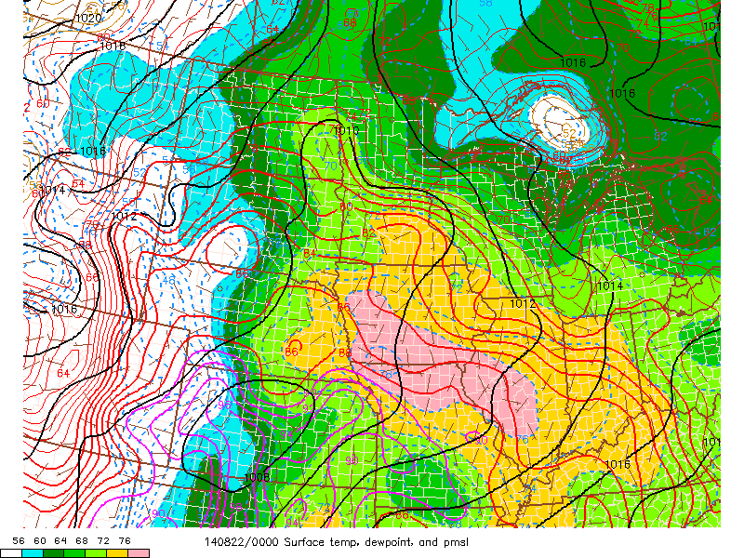
L
L

Slide 96
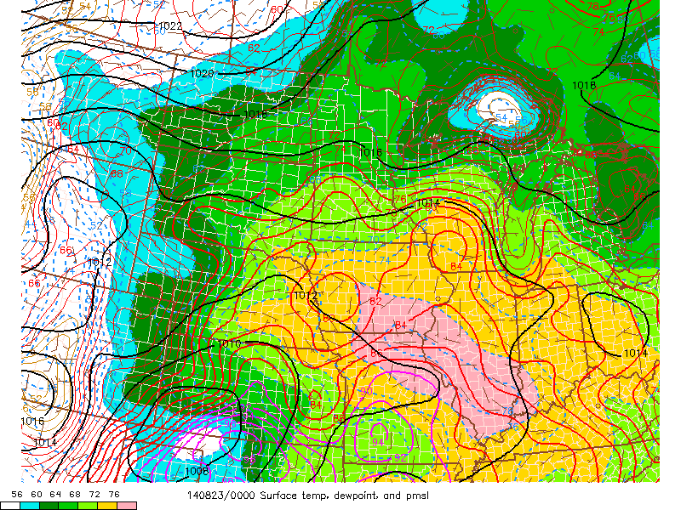
L

Slide 97
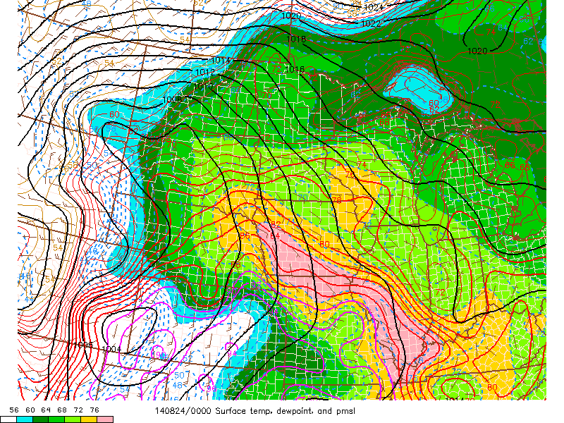
L
L

Slide 98
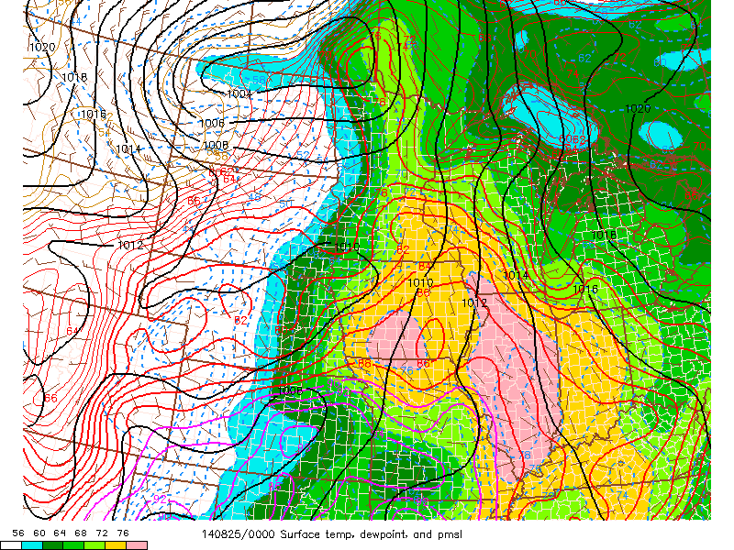
L

Slide 99
Making a quick forecast…
Consider the following Great Plains case from April…

Slide 100
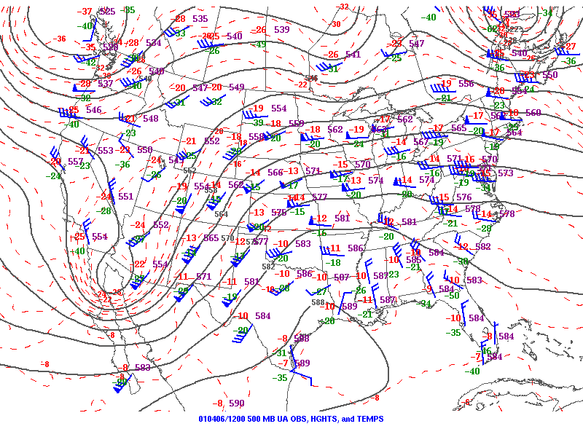

Slide 101
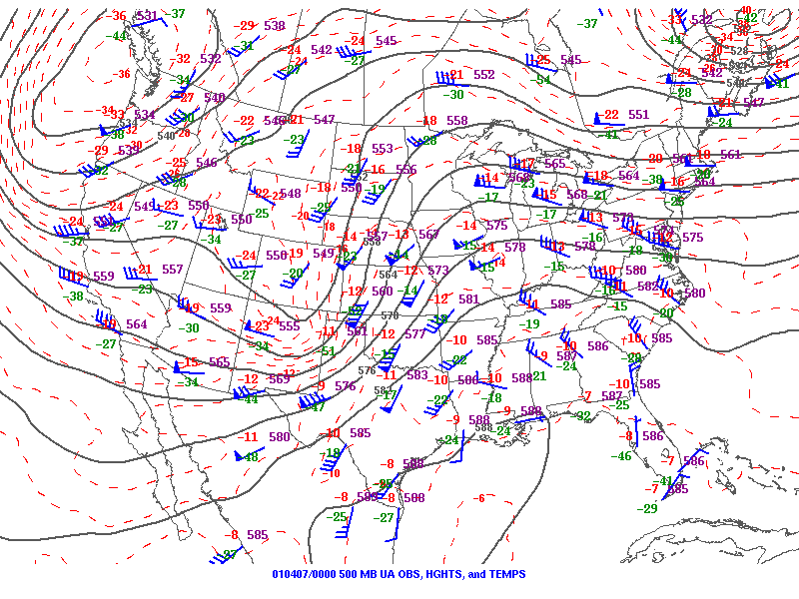

Slide 102
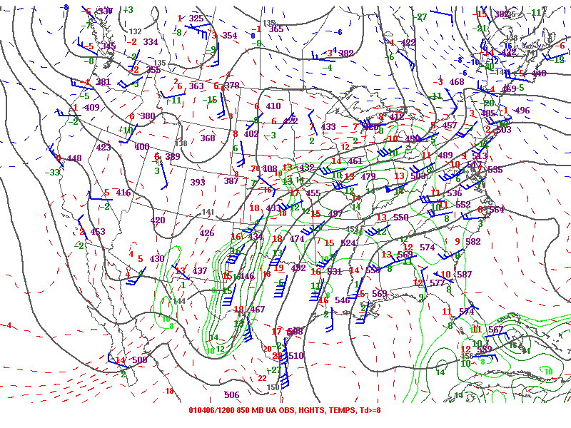

Slide 103
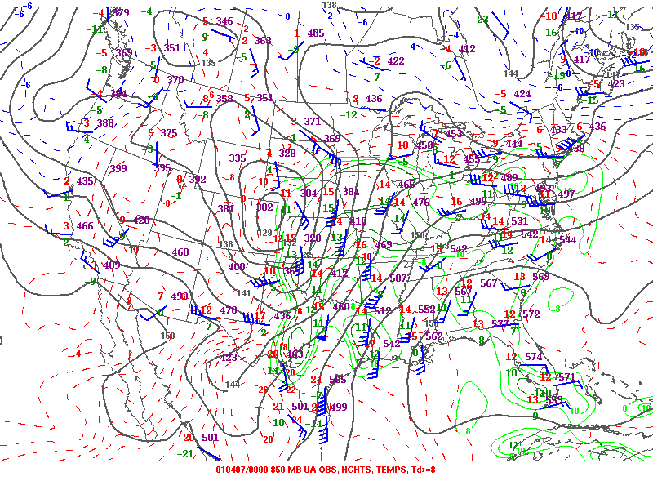

Slide 104
evening
before

Slide 105
evening
of event

Slide 106
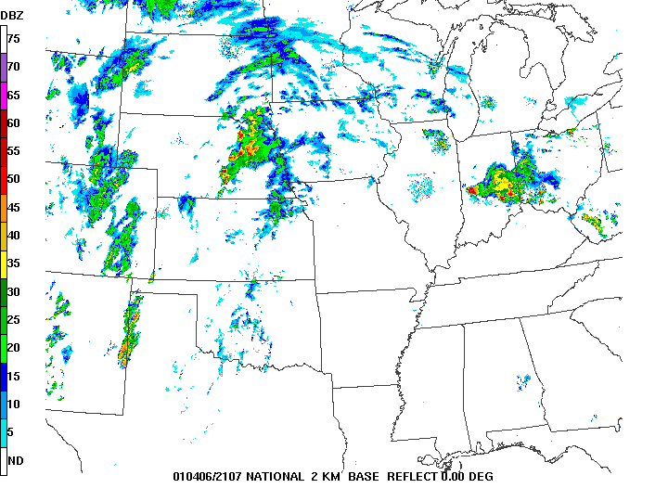

Slide 107
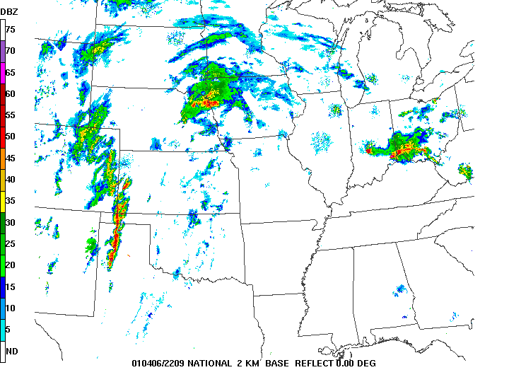

Slide 108
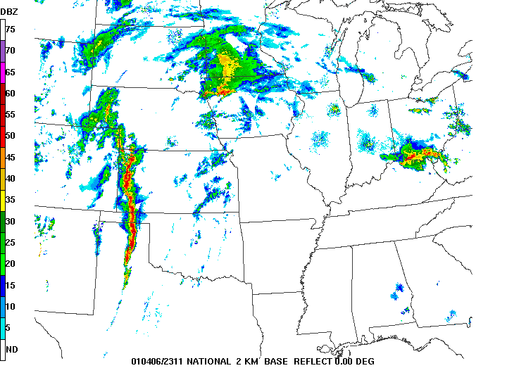

Slide 109
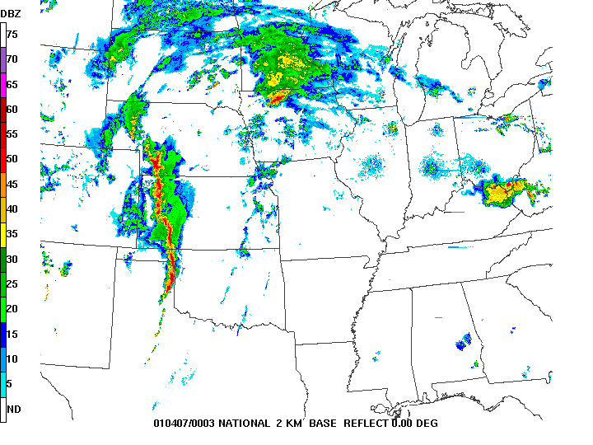

Slide 110
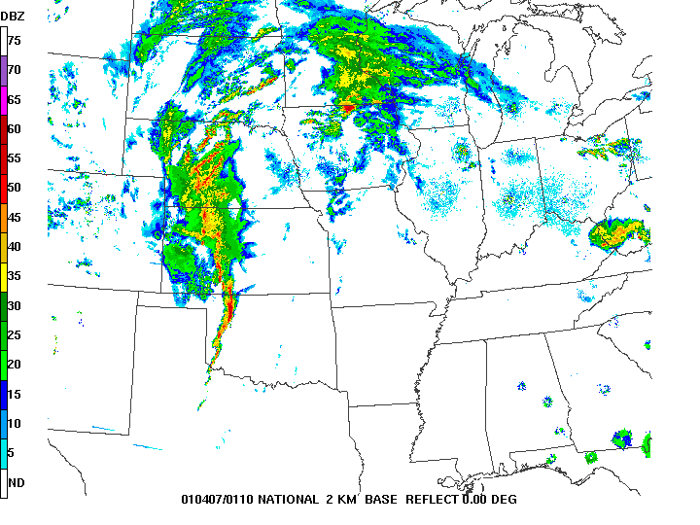

Slide 111
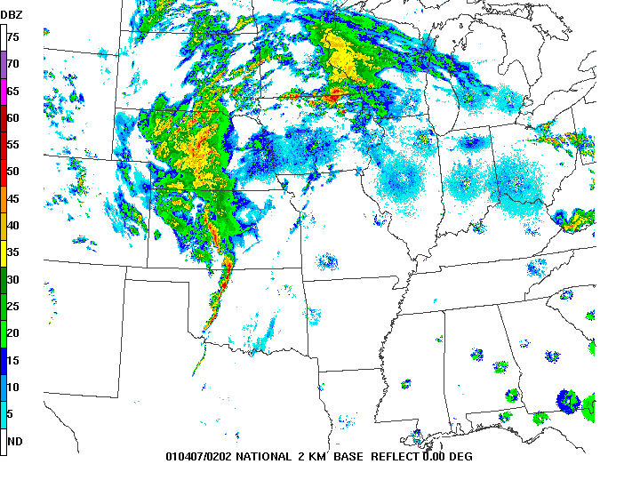

Slide 112
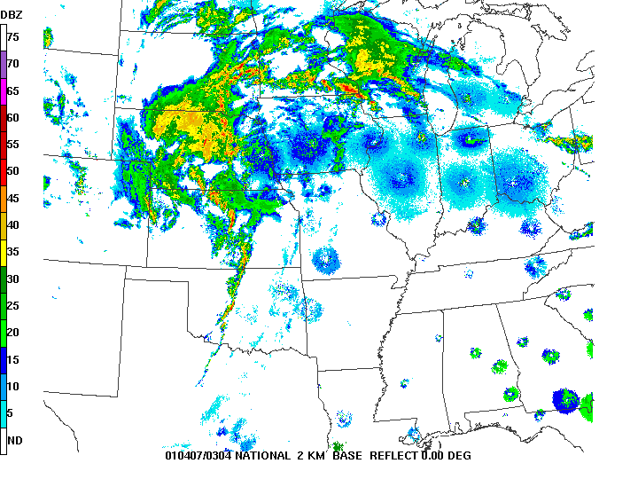

Slide 113
The details matter!
Sounding from evening before might lead you to believe a major outbreak was coming, given approaching shortwave trough
Low-level drying and warming near 700 mb reduced MLCAPE from almost 3000 J kg⁻¹ to under 500 J kg⁻¹, and increased CIN from 60 J kg⁻¹ to 600 J kg⁻¹!
Don’t assume anything – always look at observed data!

Slide 114
Low-level Moisture Summary
Air mass modification is a multi-day process
Where is the air coming from?
What are the underlying ocean characteristics?
What is the character of the returning moist layer?
Mixing and evapotranspiration:
Vertical moisture structure matters
Height and strength of “cap” matters
Are there local/regional moisture sources?

Slide 115
The Meteorology of Tornado Forecasting: Ingredients – Lapse Rates
Rich Thompson
SPC

Slide 116
Lapse rates – Elevated Mixed Layer
Starts with strong daytime heating over the high terrain of west and southwest US
Surface heating drives vertical mixing
Depth of mixed layer depends on surface warming and midlevel temperatures
Stronger heating and/or cooler midlevel temperatures result in deeper mixing and deeper layer of steep lapse rates

Slide 117
ABQ
AMA
OUN

Slide 118
evening before
ABQ

Slide 119
next
morning
AMA

Slide 121
evening of event
OUN

Slide 123
Climatology of the EML
Series of papers by Lanicci and Warner (1991)
Weather and Forecasting (June issue)
Distribution of maximum surface potential temperature
What is the “normal” dry adiabat value by month over the high terrain of the west?
See their Fig. 6 for April (36-40 C), May (40-44 C), and June (48-52 C)

Slide 124
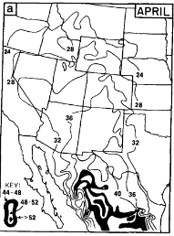
Fig. 6 Lanicci and Warner (1991)
36-40 C

Slide 125
40-44 C

Slide 126
48-52 C

Slide 127
~38 C

Slide 128
early MAY
early
JUN
early APR

Slide 129
What should you look for?
Warmer-than-normal temperatures across the Rockies can lead to a very warm EML and strong cap over the Great Plains (depends on flow regime)
Cooler-than-normal temperatures across the Rockies suggest not much EML formation, but depends on details!
EML develops over a few days, like moisture return from the Gulf of Mexico

Slide 130
LBF
OAX
DNR

Slide 131
evening before
DNR

Slide 132
next
morning
LBF

Slide 133
next evening
OAX

Slide 134
ABR
RAP

Slide 135
evening before
RAP

Slide 136
evening before
RAP

Slide 137
next morning
ABR

Slide 138
evening before
ABR

Slide 139
Differential Advection
Steep lapse rates in mid levels from high terrain to the west
Moist layer in low levels from Gulf of Mexico to the south
Creates “loaded gun” profile

Slide 141
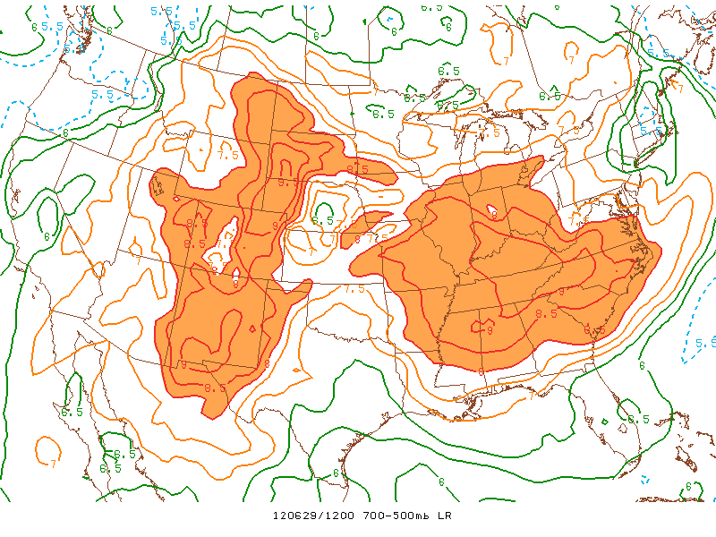
EML plume can reach eastern US!

Slide 142
EML and the “cap”
Cap strength related to:
Warmth of EML
Depth and quality of low-level moisture
Degree of surface heating and mixing in moist sector

Slide 143
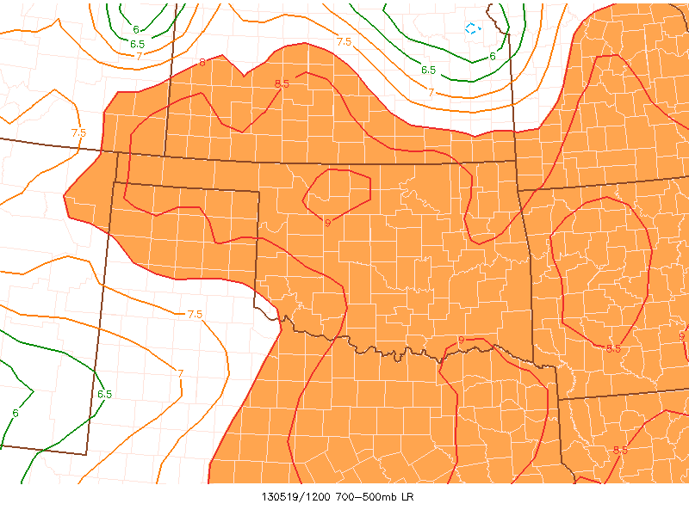

Slide 144
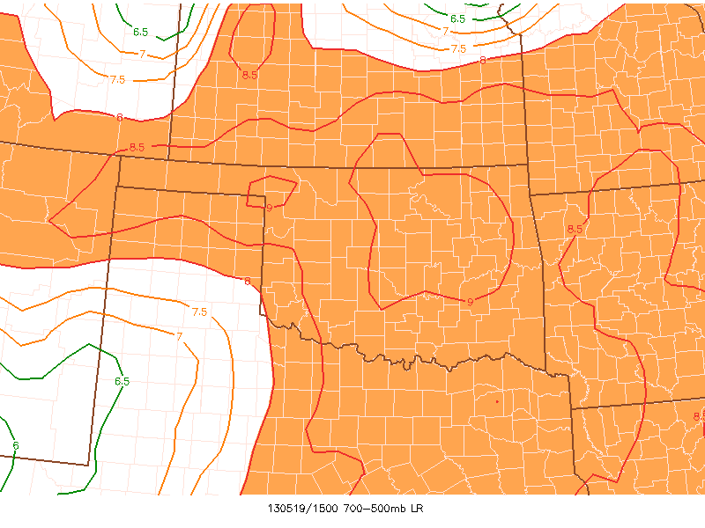

Slide 145
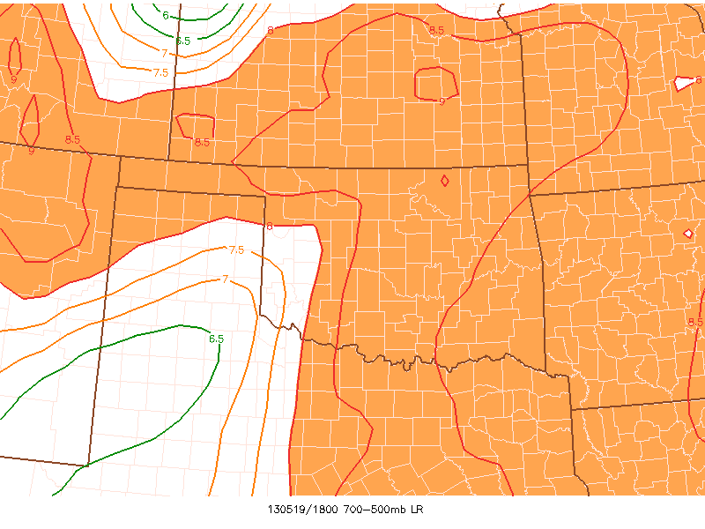

Slide 146
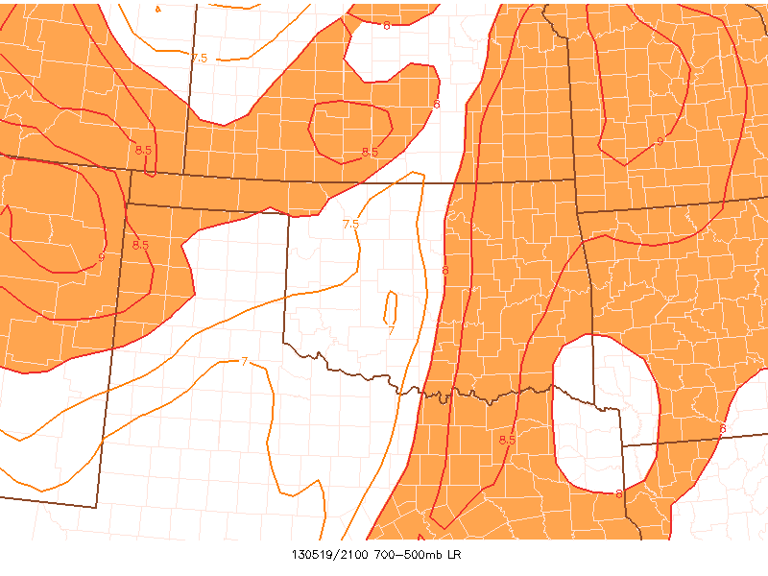

Slide 147
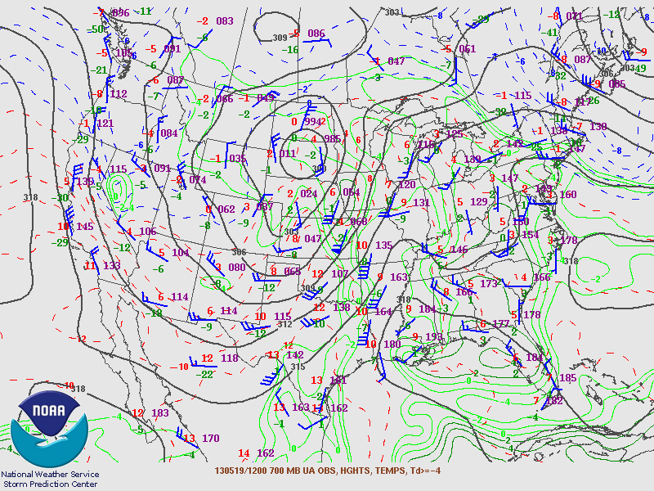

Slide 148
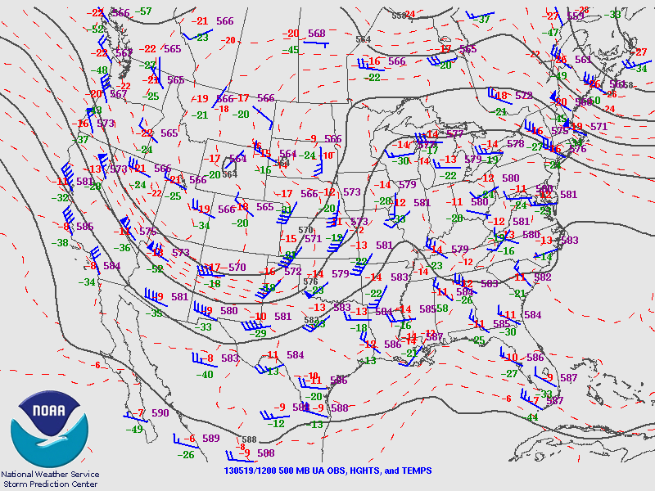

Slide 150
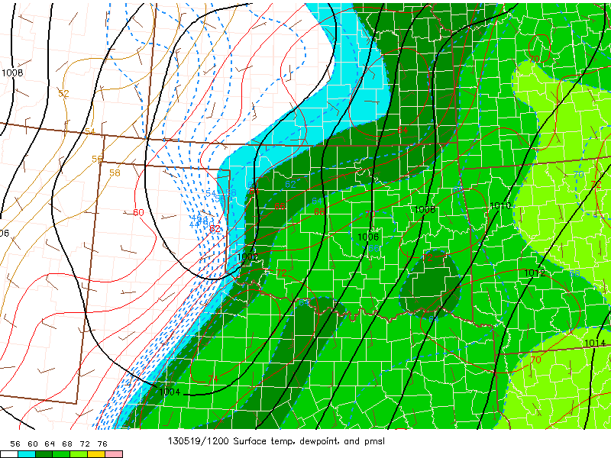

Slide 151
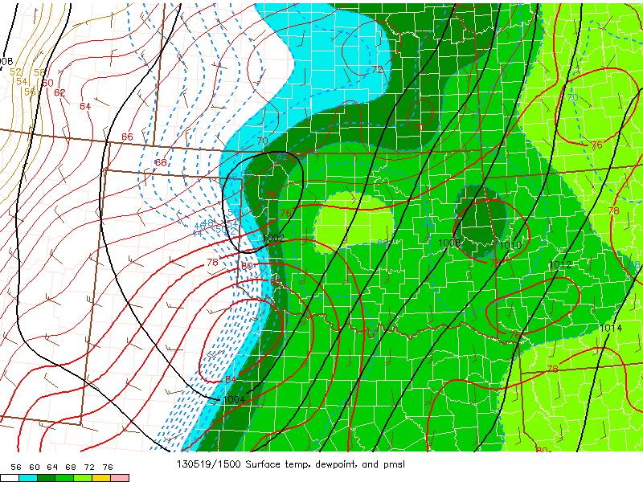

Slide 163
afternoon
OUN

Slide 164
afternoon
LMN

Slide 174
Always check observations!
Compare available observed soundings to mesoanalysis graphics
What about scenarios without an obvious EML?

Slide 181
What’s up next?
What’s up next?

Slide 182
6 hours of 10 cm s ⁻¹

