Slide 1

The Meteorology of Tornado Forecasting:
Supercells and Tornadoes
Rich Thompson
SPC

Slide 2
Workshop Organization
Observations, convective processes, and synoptic processes:
  How to read weather maps and sounding diagrams
  “Q-G Theory”, jet streaks, fronts, cyclones
Severe thunderstorm ingredients:
  Moisture and lapse rate sources
Severe thunderstorm ingredients:
  Lift and vertical wind shear sources
Supercell and tornado conceptual models
  Reasons behind parameter development

Slide 3
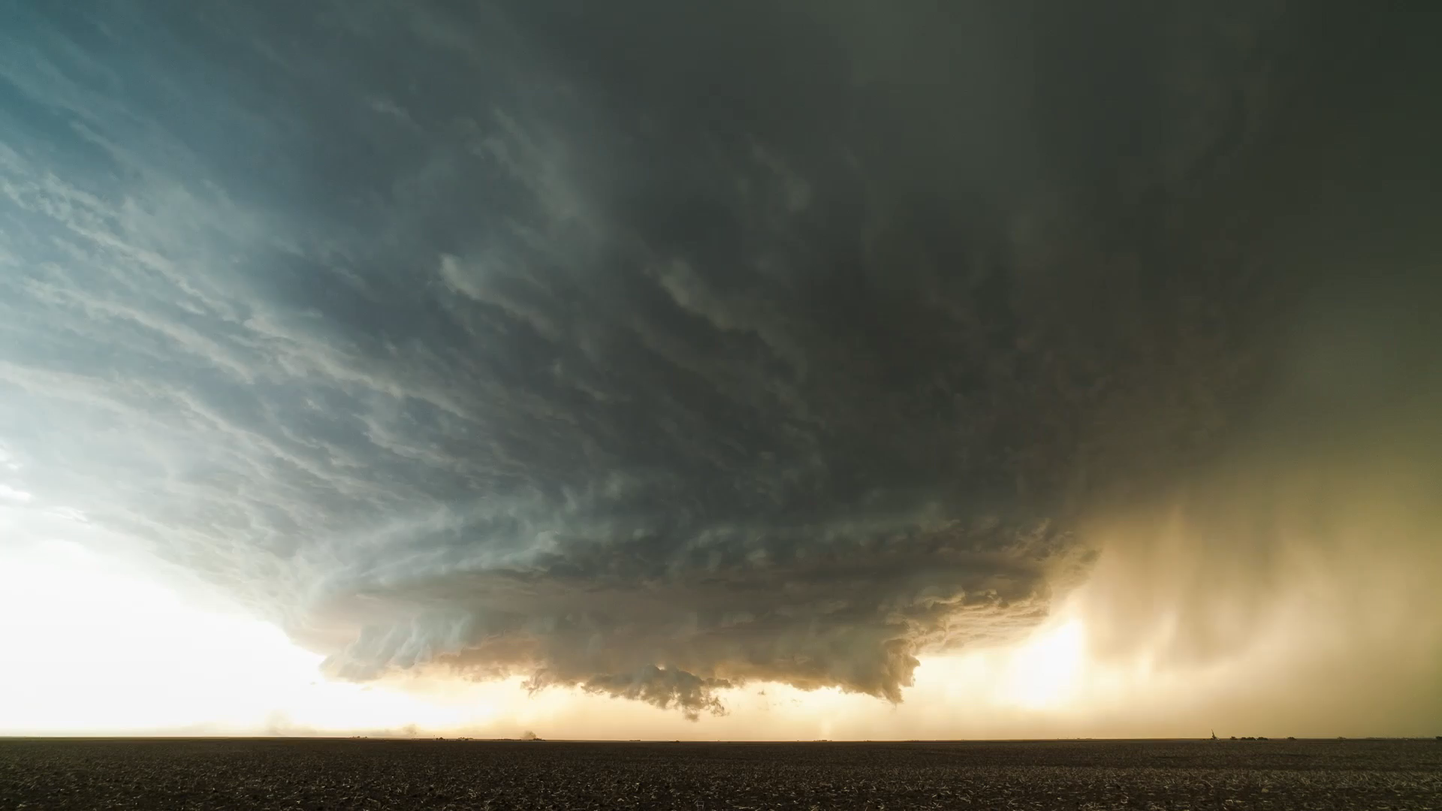
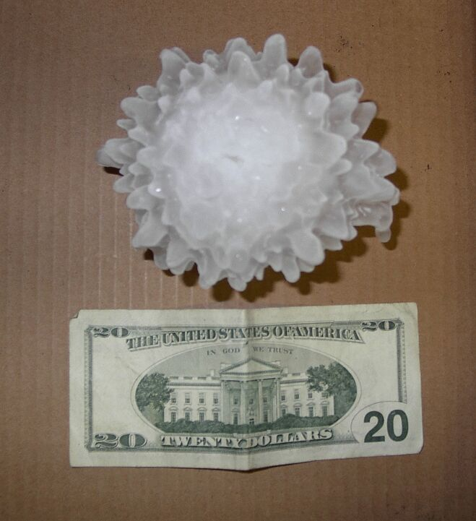
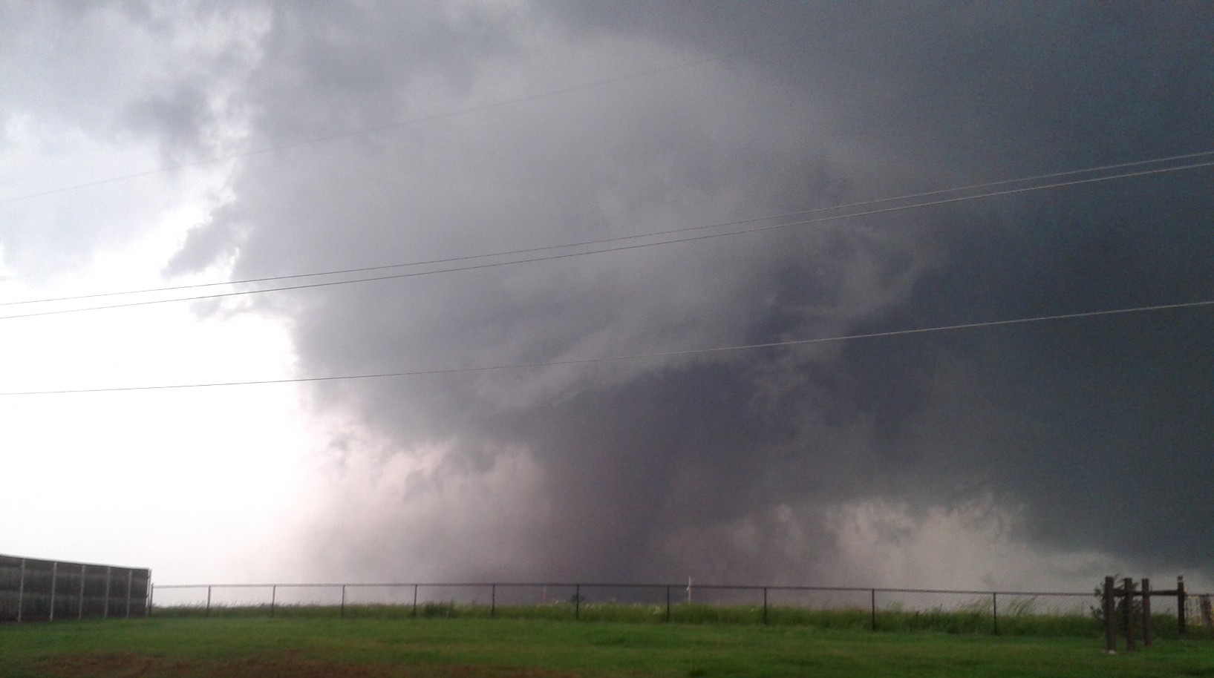
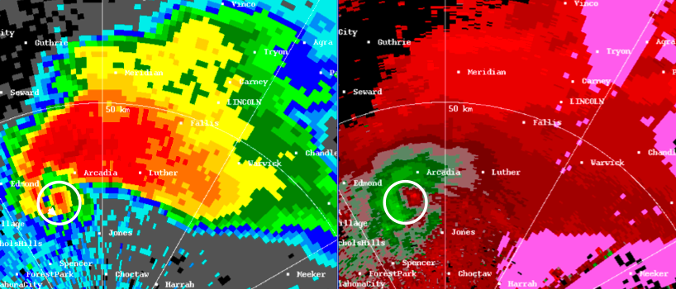
Supercell storms
Storms with a rotating updraft (“mesocyclone”)
mesocyclone
Adapted from Lemon & Doswell (1979)
Courtesy of Mike Olinski
reflectivity
radial velocity
velocity couplet associated with mesocyclone
Moore, OK, 20 May 2013
hook echo

Slide 4
What makes a supercell?
Buoyancy (CAPE) – energy source for thunderstorm updraft
Vertical wind shear – source of rotation
Hodograph shape and length
  Straight favors storm splits
  Curved (clockwise) favors cyclonic storms
Storm mode – discrete or cluster

Slide 5
Importance of Midlevel Rotation
Rotating updraft is stronger than buoyancy alone would suggest, below level of maximum rotation
  Can draw air into the updraft, allowing storm to continuously regenerate (propagate)
Rotating updrafts are more resistant to entrainment/decay
  Results in a stronger, longer-lived storm

Slide 6
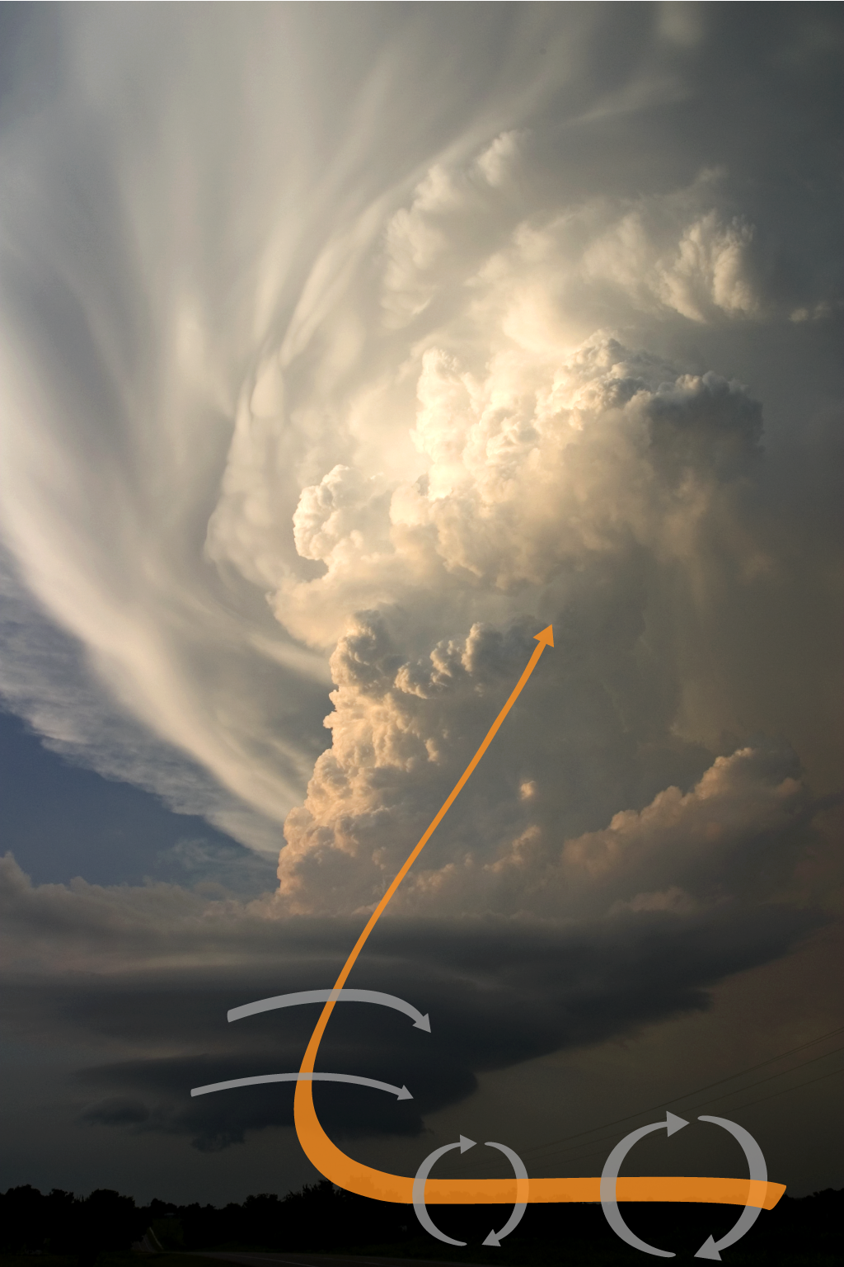
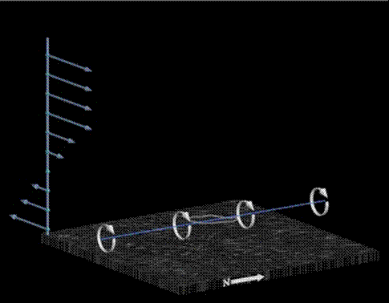
Supercell storms
Supercells acquire rotation aloft by tilting horizontal vorticity associated with the environmental vertical wind shear
(net cyclonic updraft rotation, i.e. a helical updraft, is acquired by tilting streamwise horizontal vorticity)
Idealized evolution of a vortex line
Eric Nguyen
from COMET

Slide 7
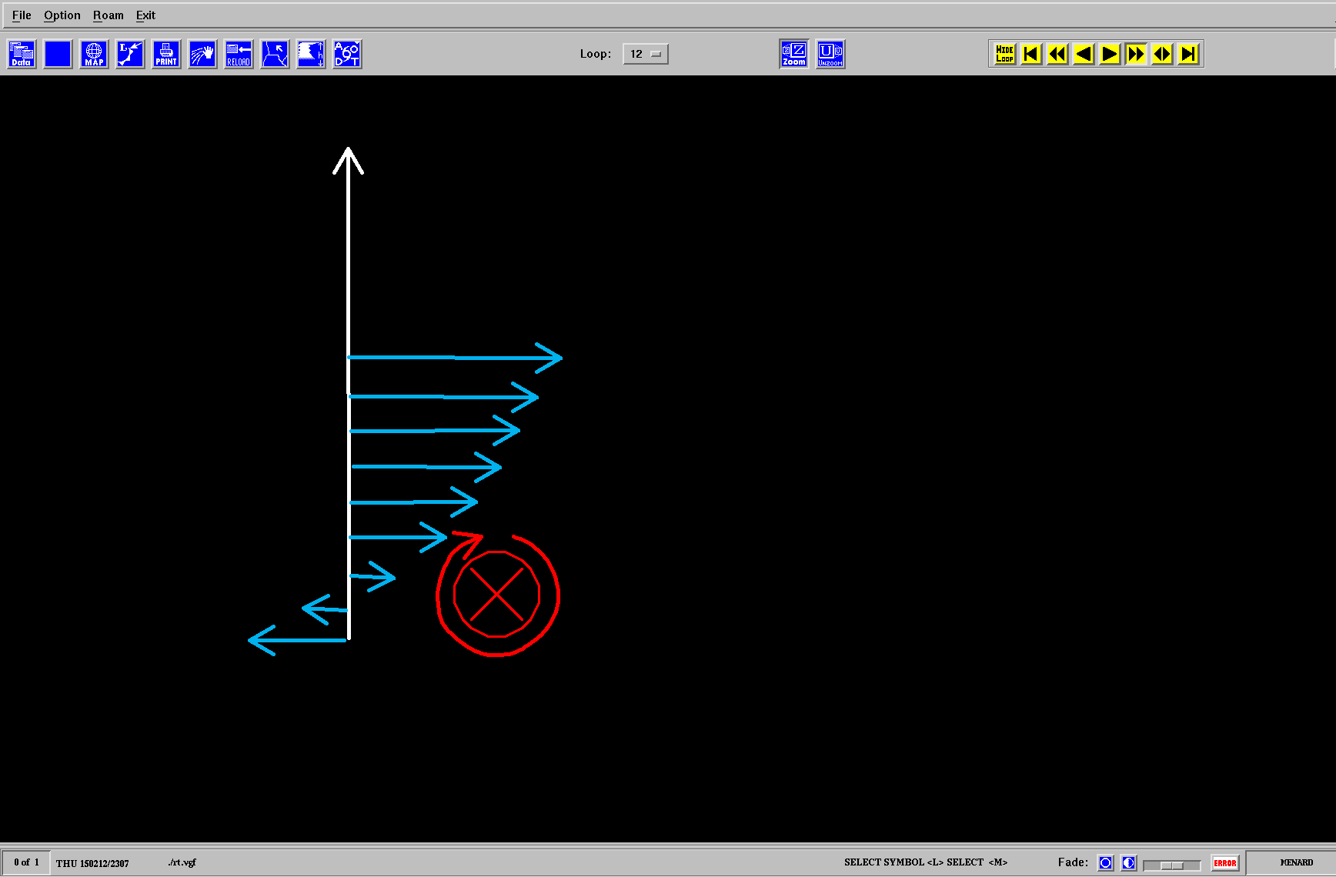
UP
ground

Slide 8
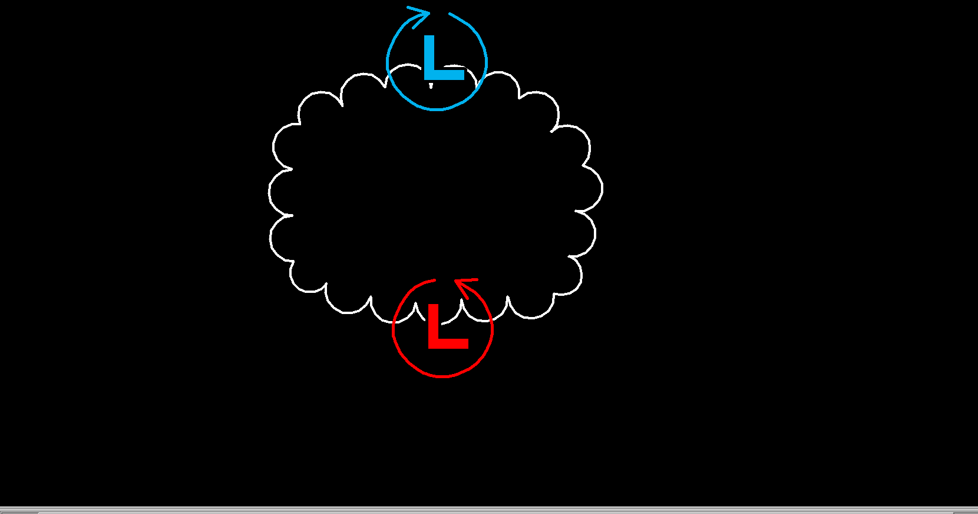
Looking down at Midlevel Updraft
mean wind

Slide 9
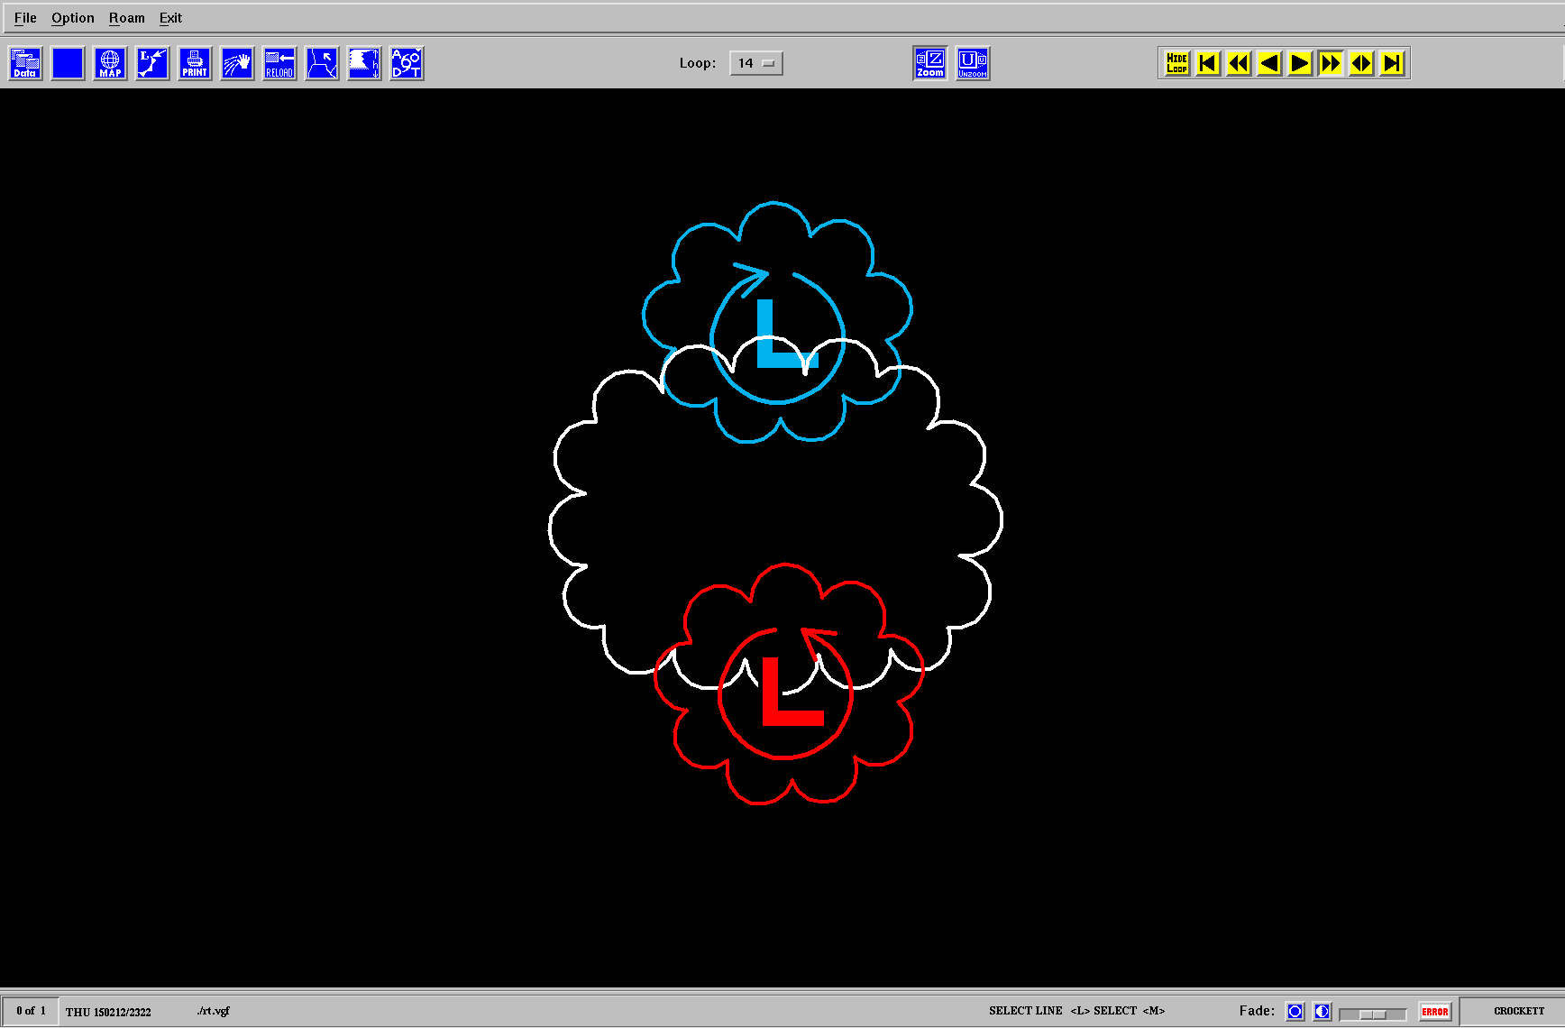
New updraft and storm motion
New updraft and storm motion

Slide 10
Straight hodograph case
Vertical wind shear provides source for rotating updraft (“vortex tubes”)
Initial weak rotation on edges of an updraft results in weak low pressure aloft, which draws air from below and creates new updrafts on both sides of initial updraft (“propagation”)
Net result of propagation is stronger storm rotation (vorticity becomes “streamwise”)

Slide 11
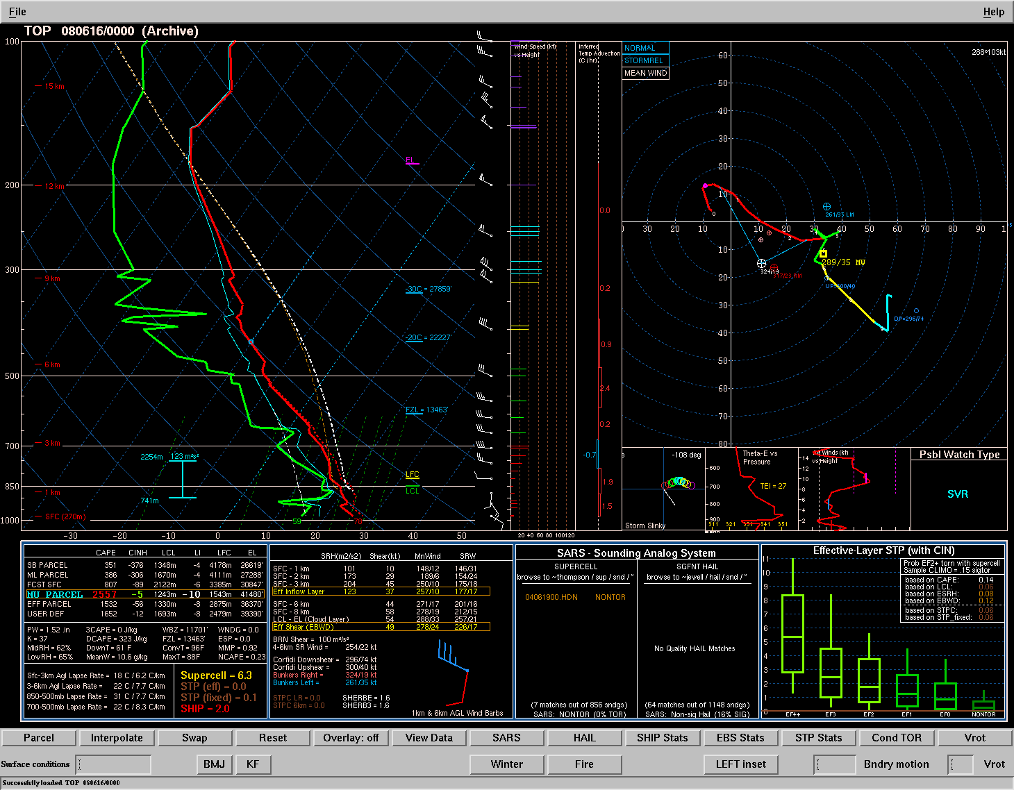

Slide 12
vorticity vector – crosswise near 1 km
mean wind

Slide 13
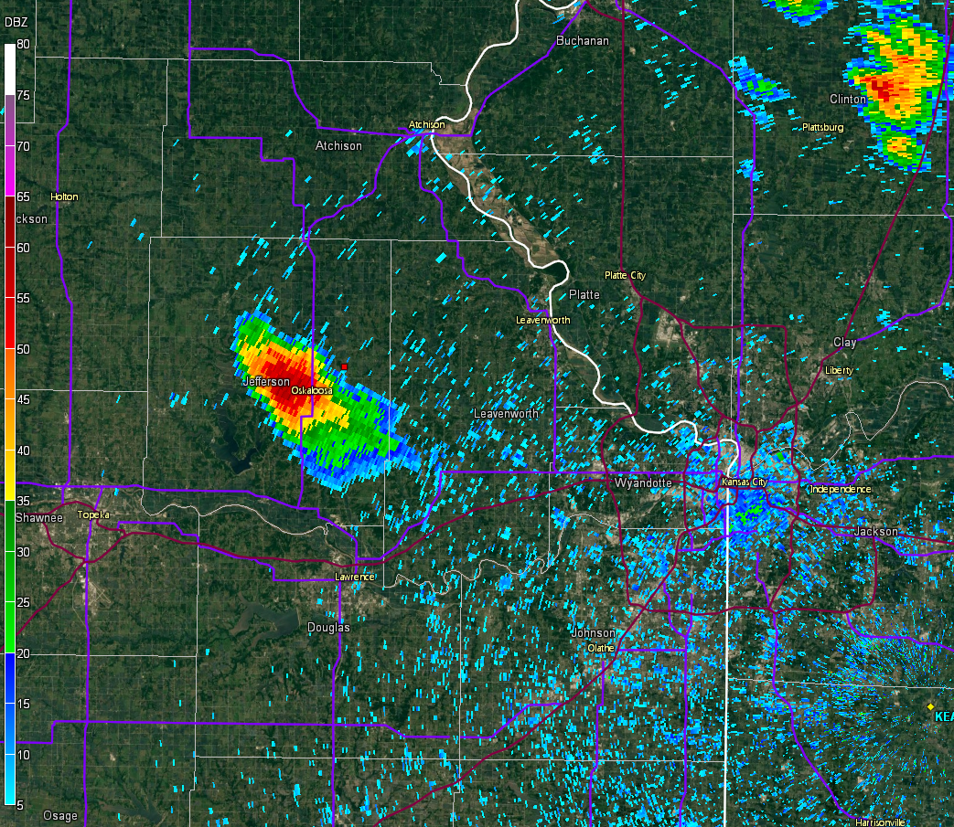

Slide 14
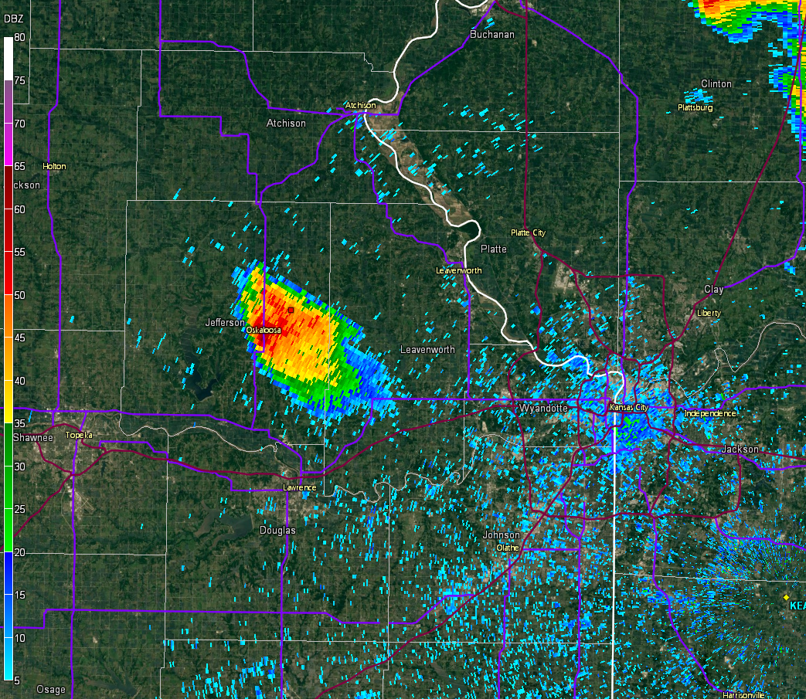

Slide 15
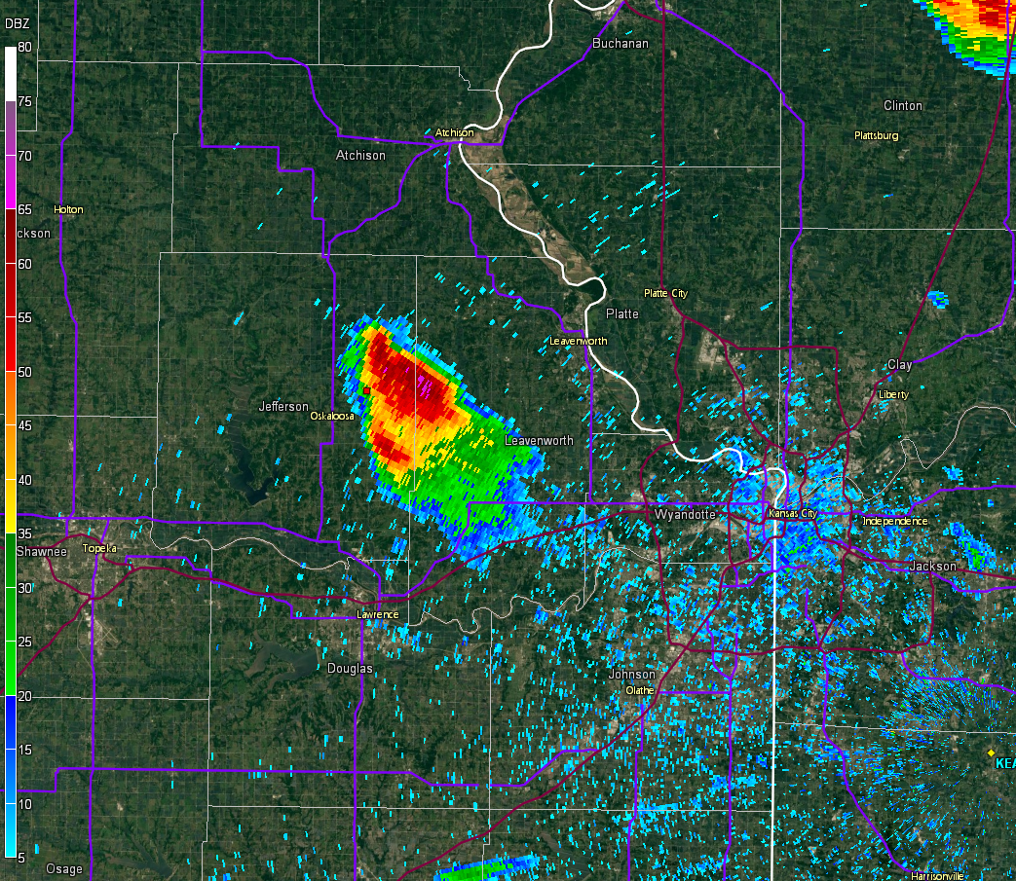

Slide 16
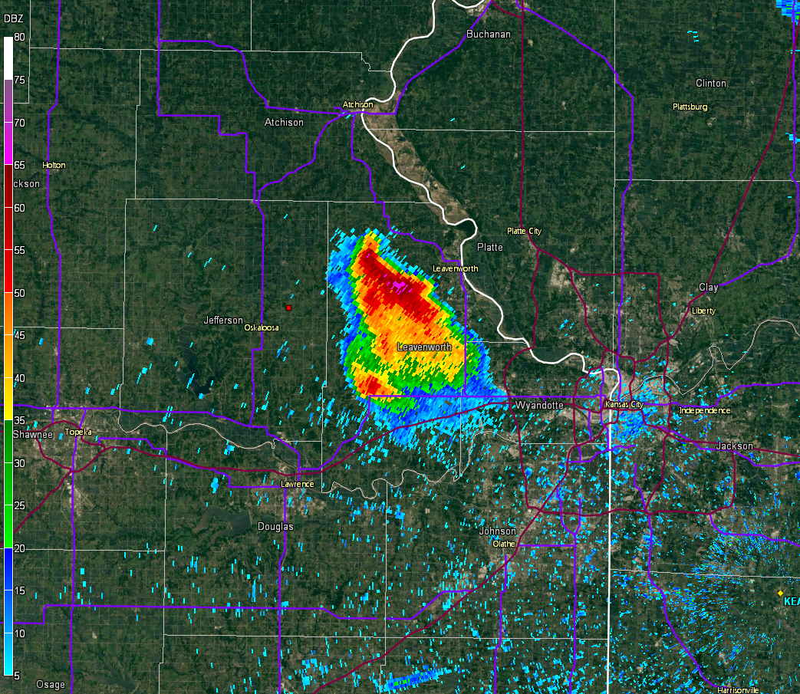

Slide 17
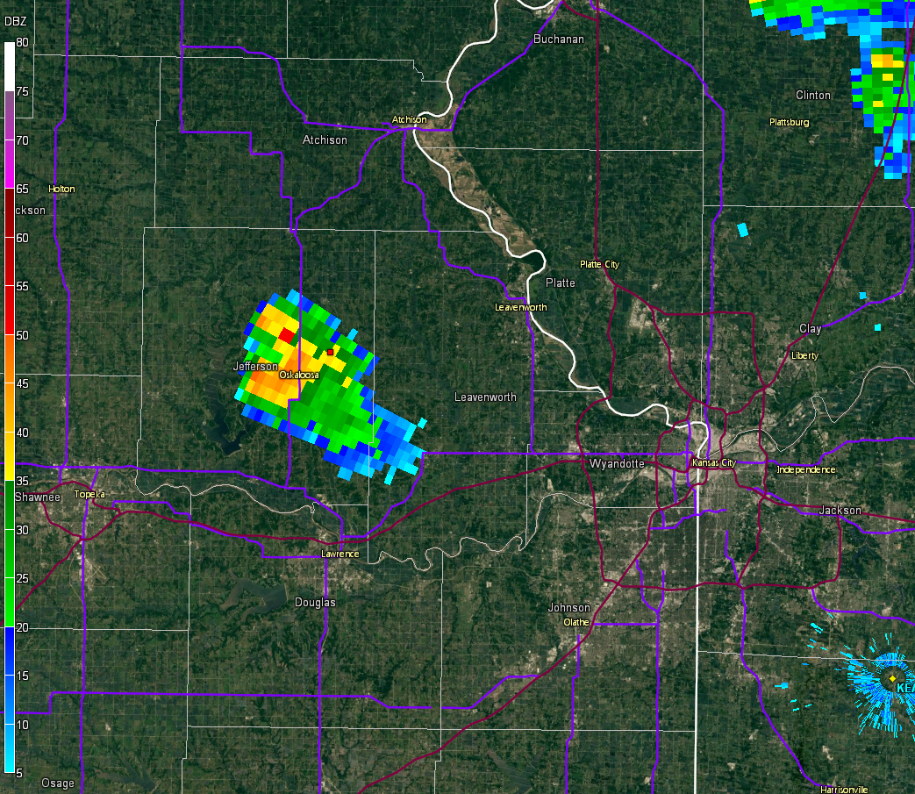

Slide 18
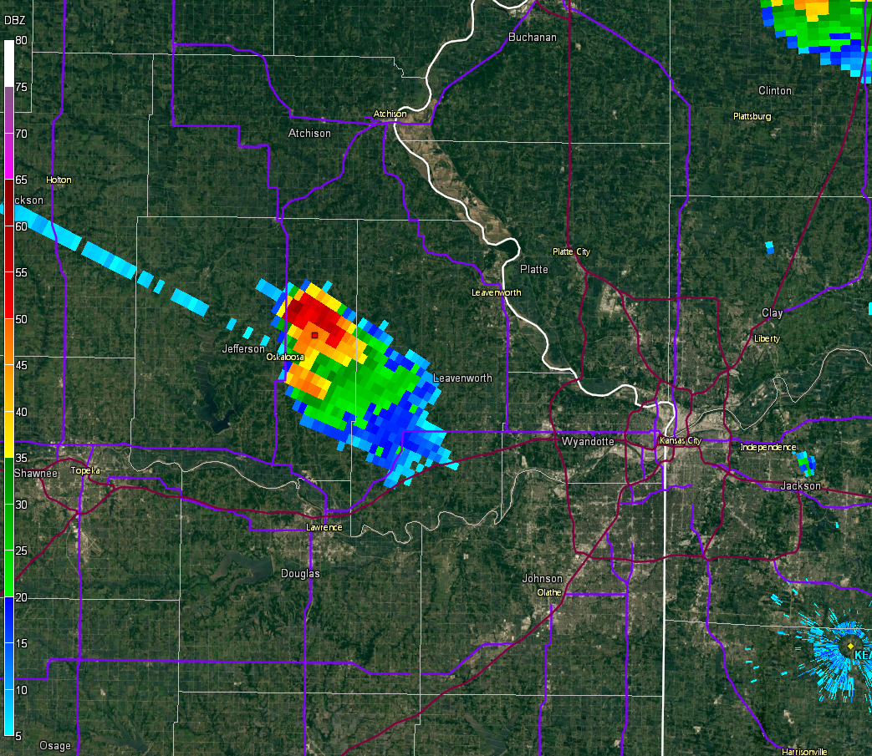

Slide 19
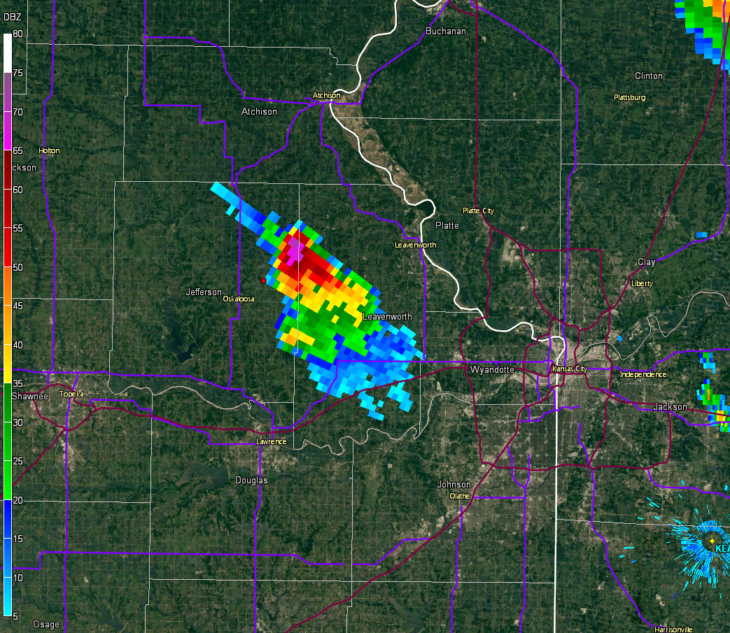

Slide 20
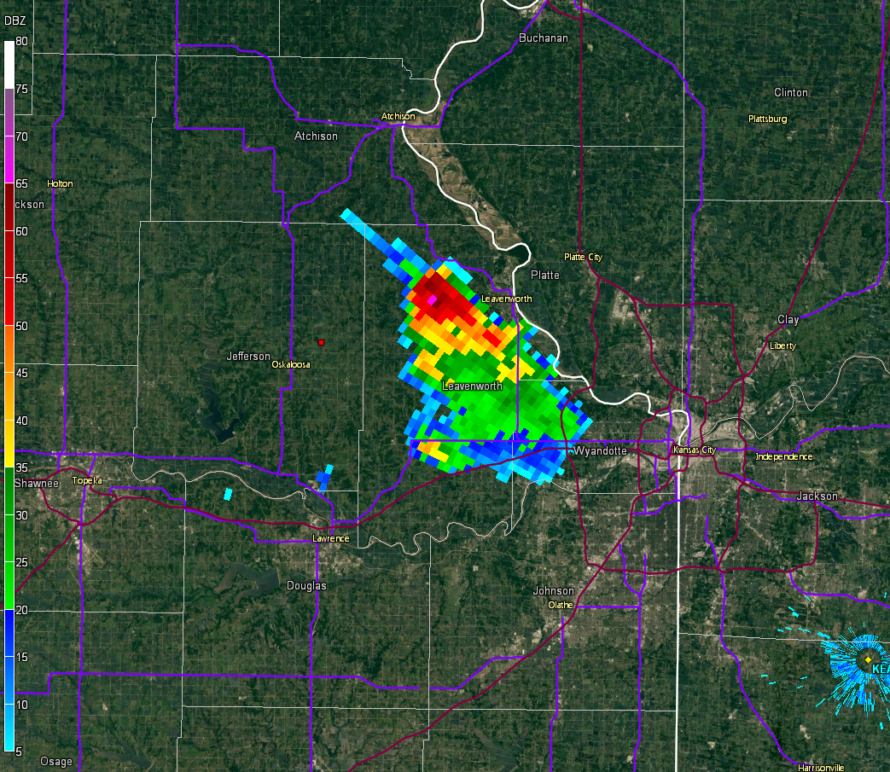

Slide 21
Curved hodograph case
Unlike straight hodograph case, the initial updraft rotates in the curved hodograph case (vorticity already “streamwise” before any storm propagation)
Clockwise curvature immediately favors cyclonic (right-moving) supercells
Counterclockwise curvature immediately favors anticyclonic (left-moving) supercells

Slide 22
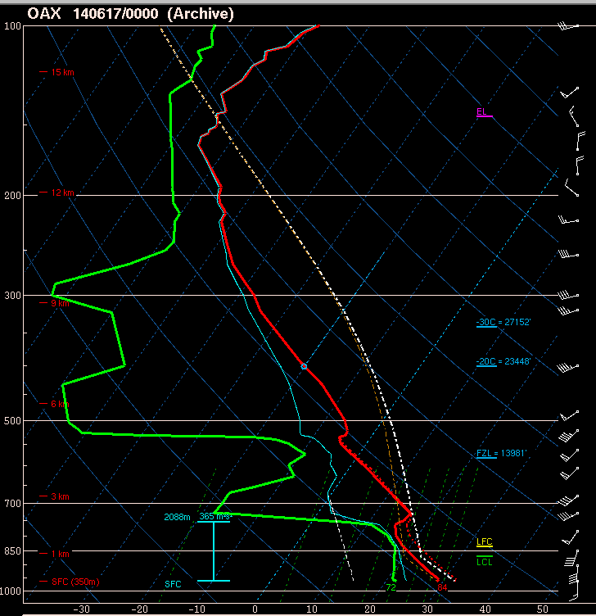

Slide 23
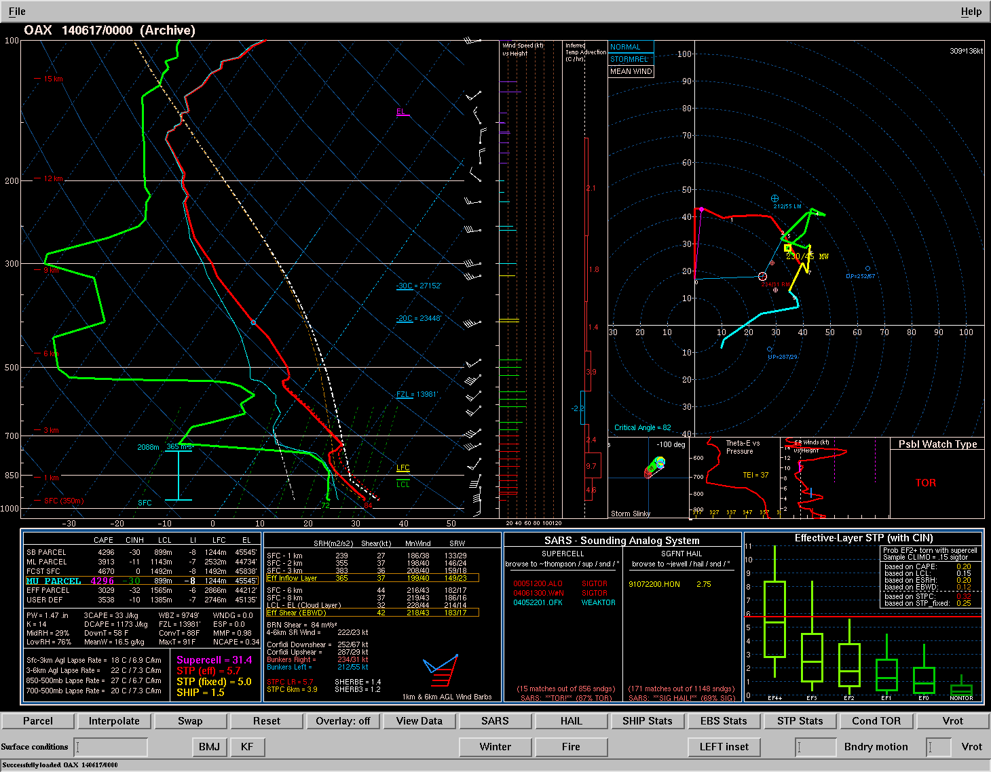
vorticity vector – streamwise below 1 km
mean wind

Slide 24
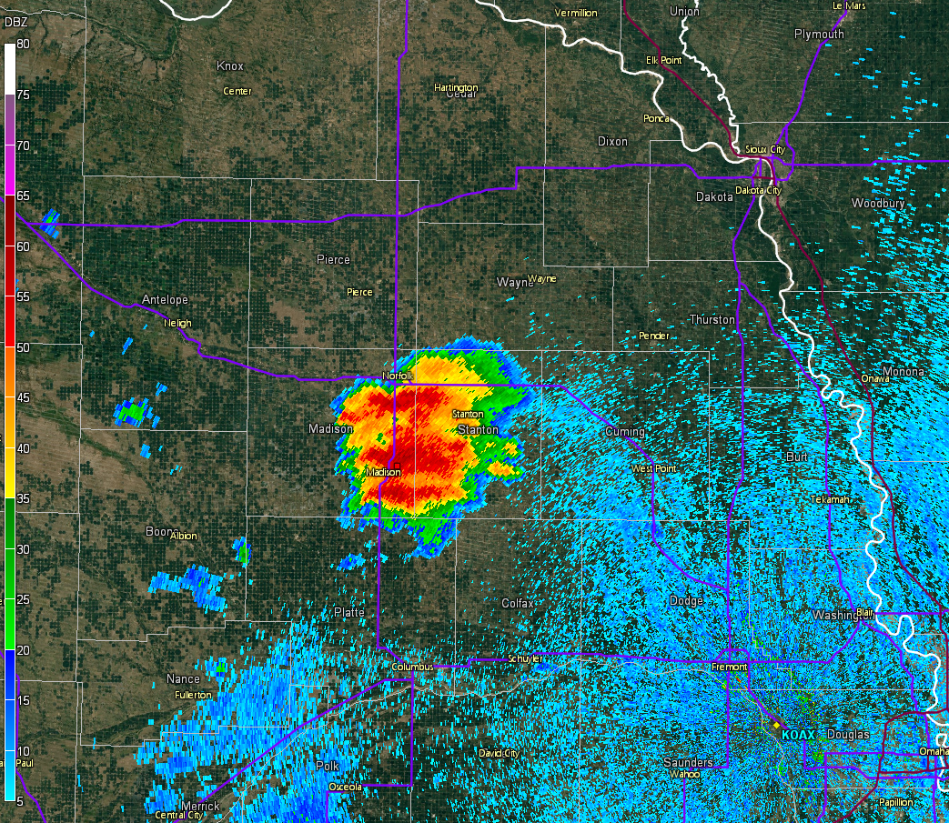

Slide 25
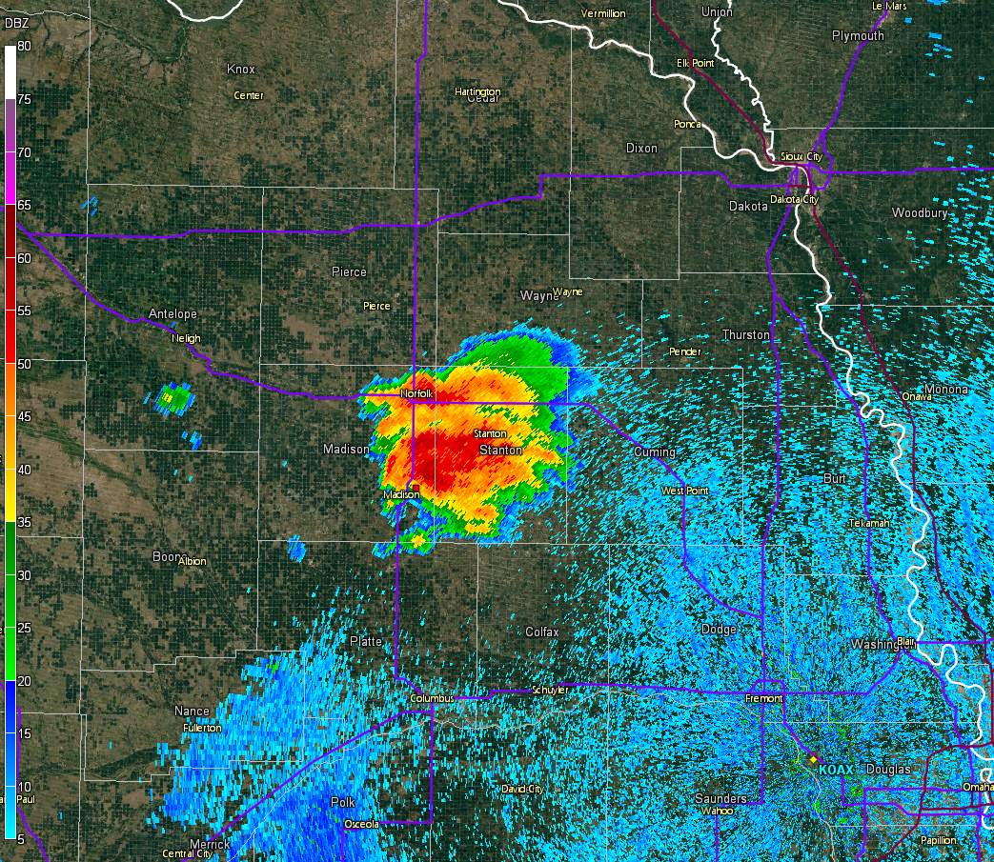

Slide 26
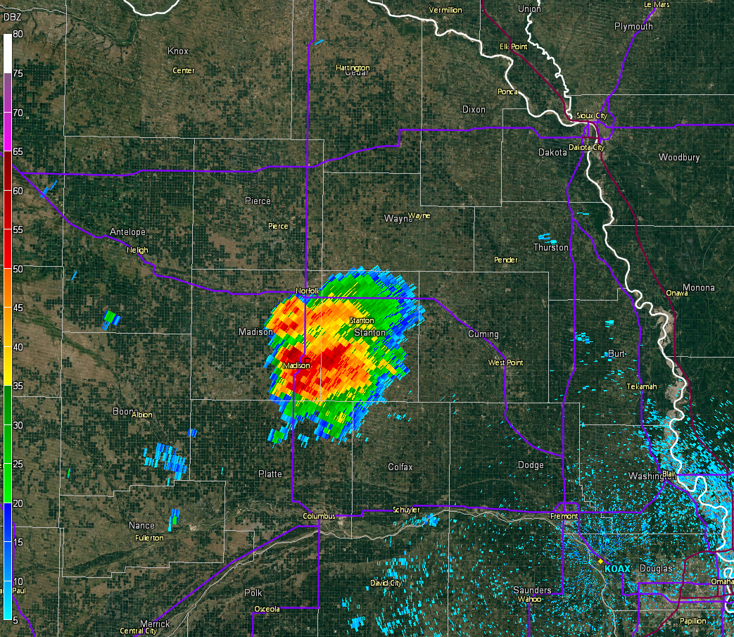

Slide 27
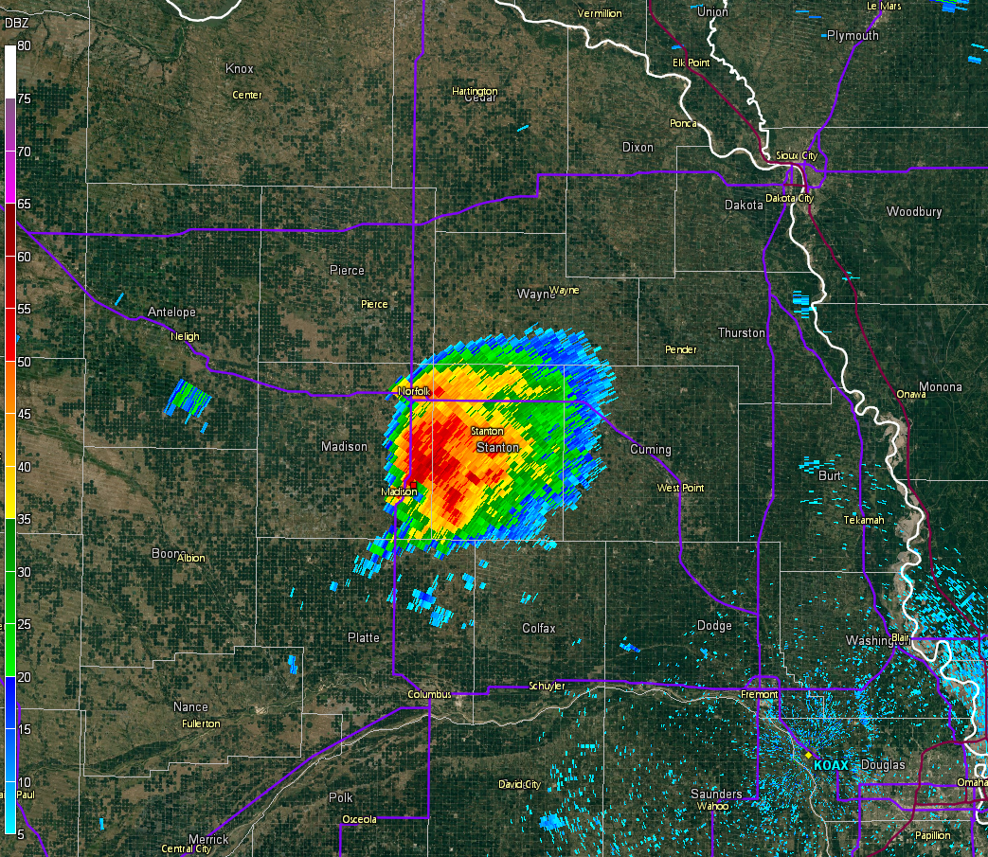

Slide 28
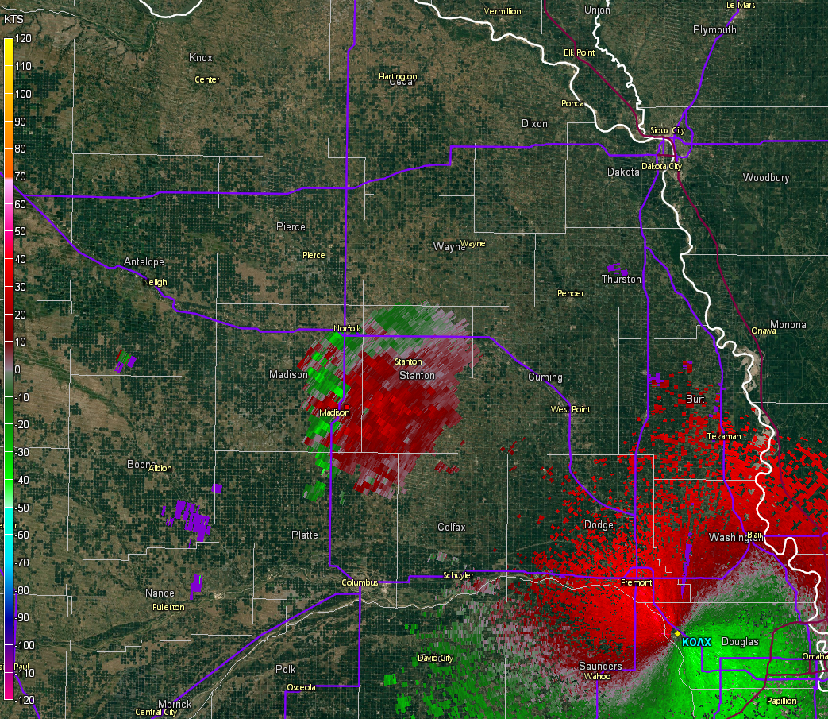

Slide 29
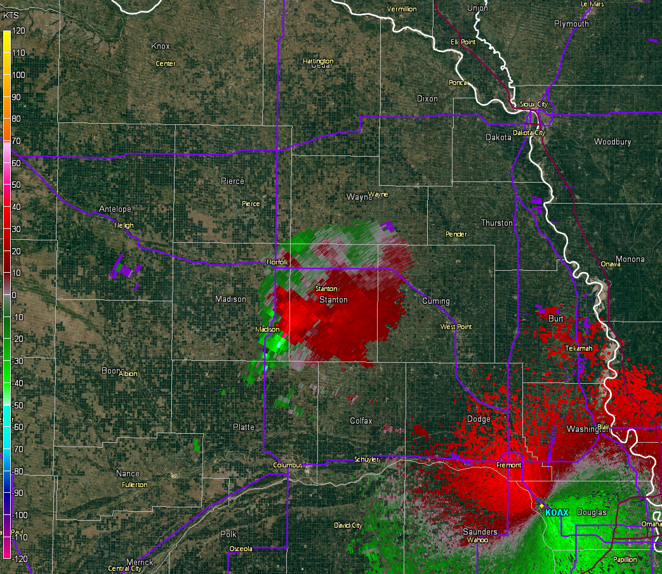

Slide 30
Supercell Formation vs. Persistence
Does environment influence supercell development vs. supercell persistence?
  Answer appears to be “yes”
May need a little more CAPE and less CIN to get storms going, but mature (intense) supercells can persist into weaker CAPE than you might expect!

Slide 31
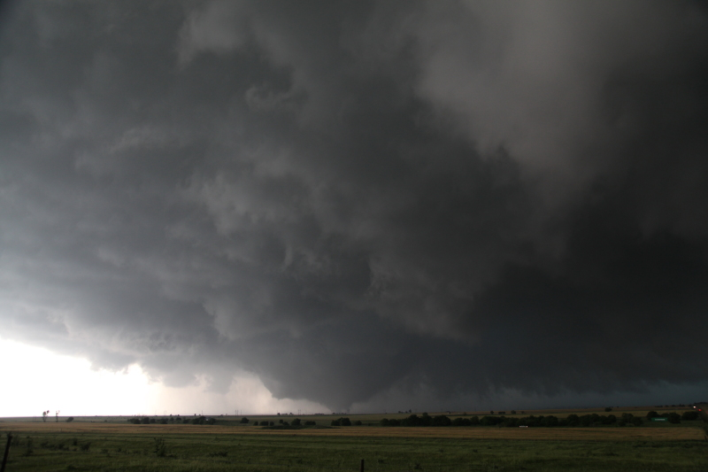
Tornadogenesis

Slide 32
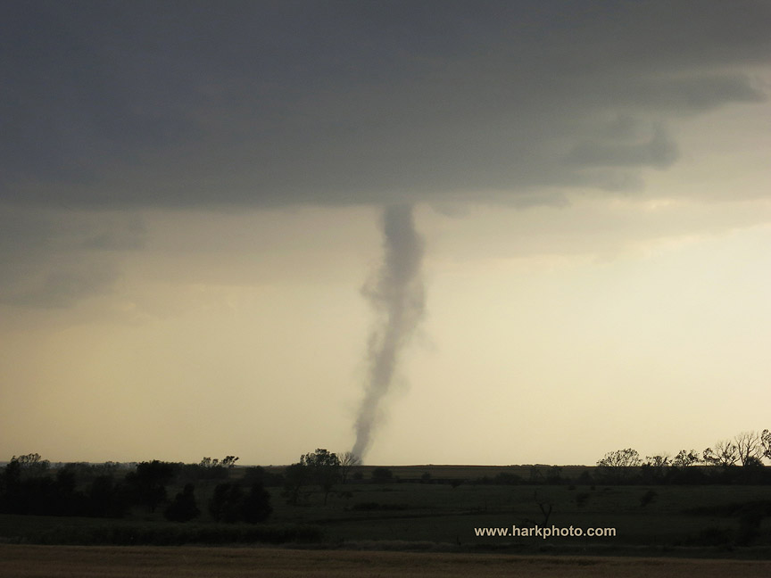
Tornadogenesis Basics
Source for near-surface vorticity (spin)
Source for vortex stretching
These necessary conditions can be met by a wide variety of surface-based convection
Supercells can provide persistent (repeatable) sources of both near-surface vertical vorticity and low-level stretching

Slide 33
Non-mesocyclonic tornadoes
“Swirlies” along pre-existing boundaries are often the vertical vorticity source
Boundaries are also preferred locations for new updraft development – stretching source
If enough spin and stretching, can get a tornado

Slide 34
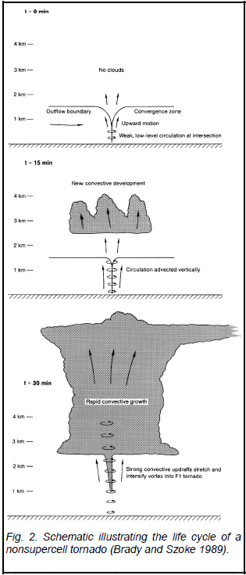

Slide 35
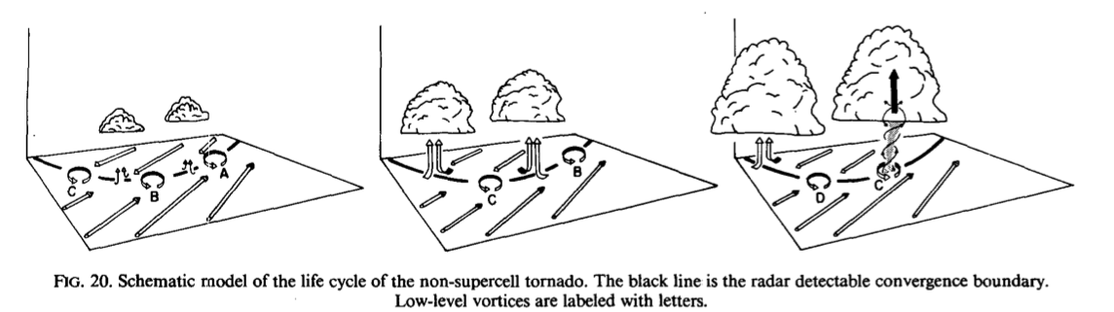

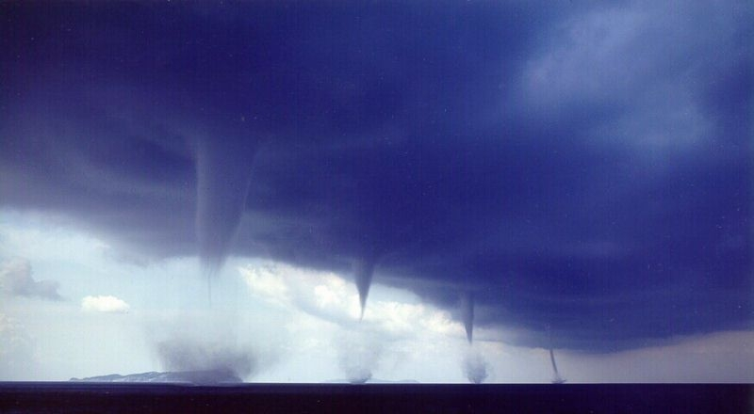
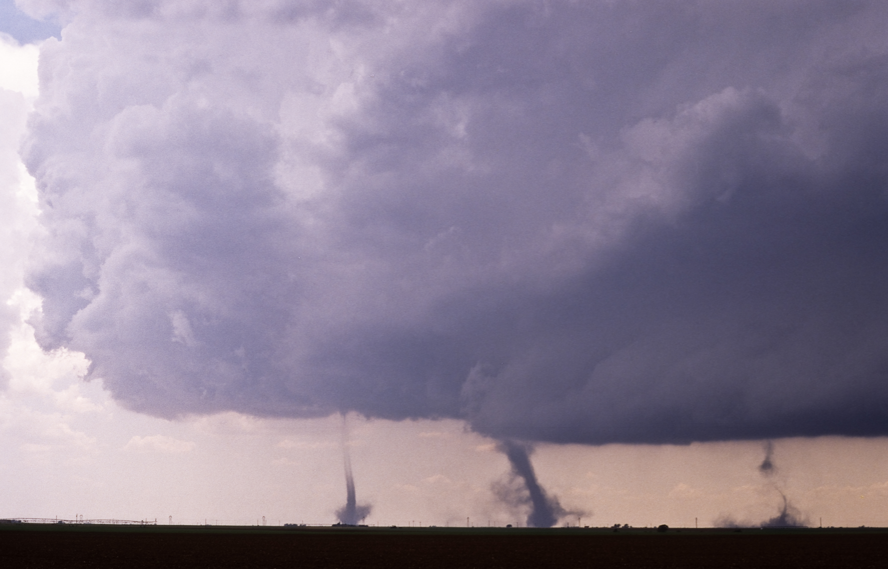
Non-mesocyclonic tornadoes
Non-supercell tornadoes also can develop owing to the stretching of pre-existing near-surface vertical vorticity
(such as a vortex sheet associated with a wind-shift line that pre-exists the convection)
Wakimoto & Wilson (1989)
“waterspouts”
“landspouts”
Roberto Giudici
Peter Blottman

Slide 36
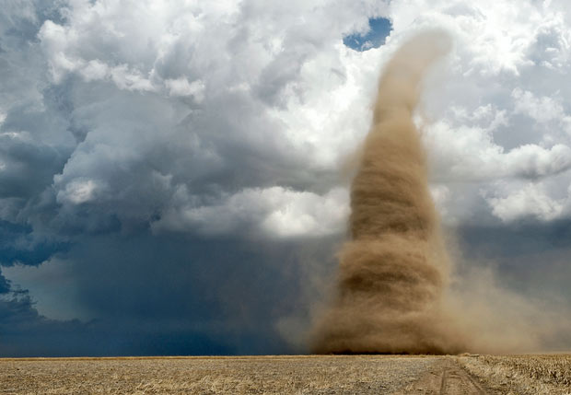
Non-mesocyclonic Tornado Example
Courtesy of Jim Reed

Slide 37
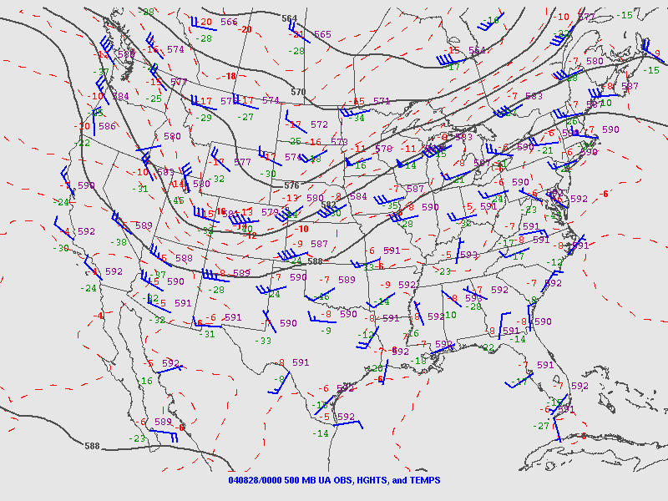

Slide 38
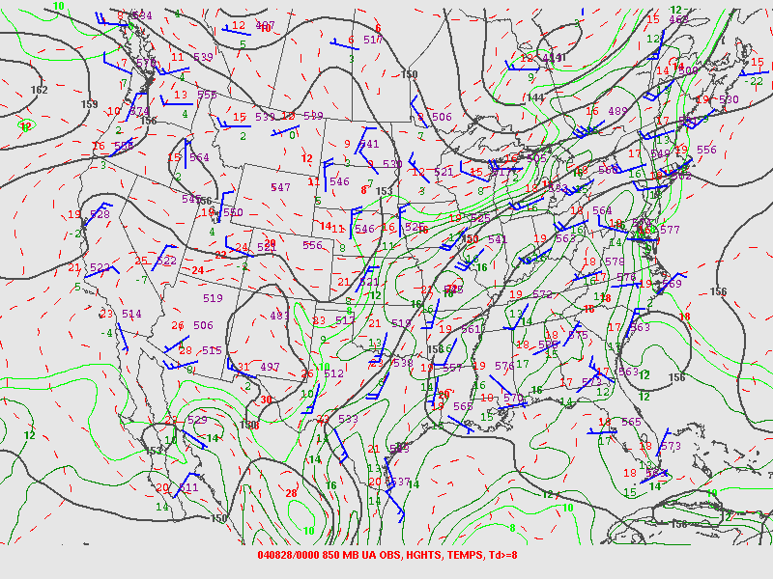

Slide 39
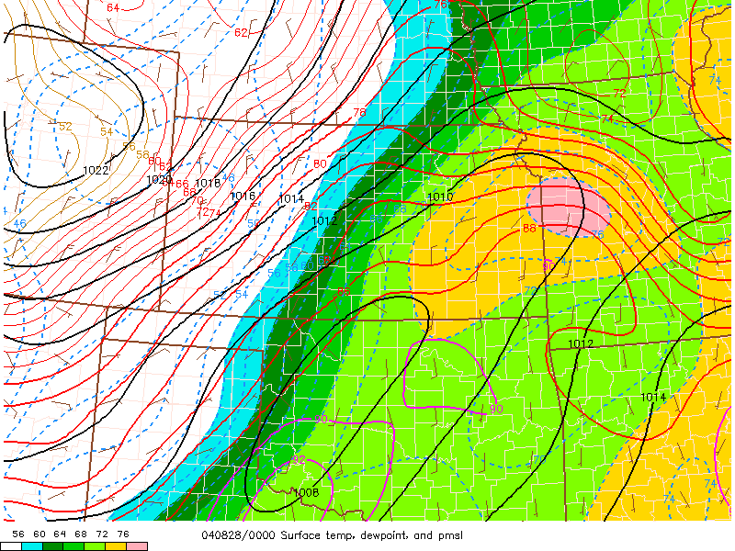

Slide 40
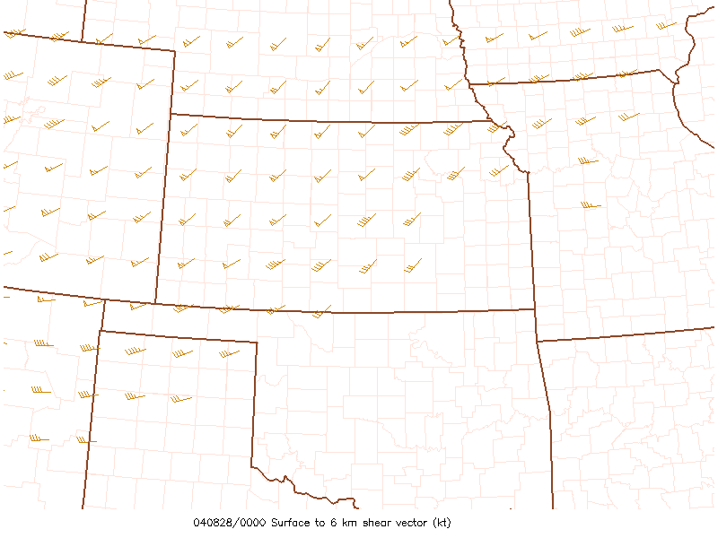

Slide 41
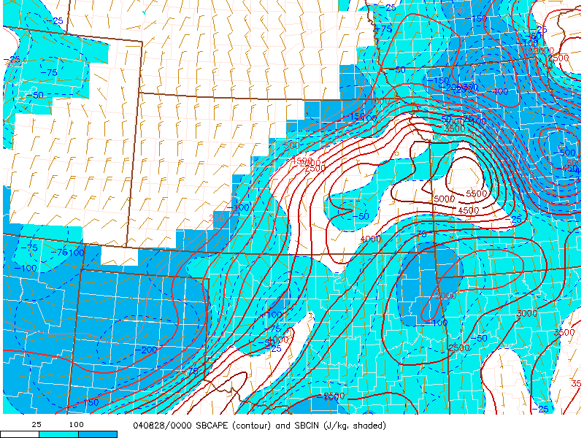

Slide 42
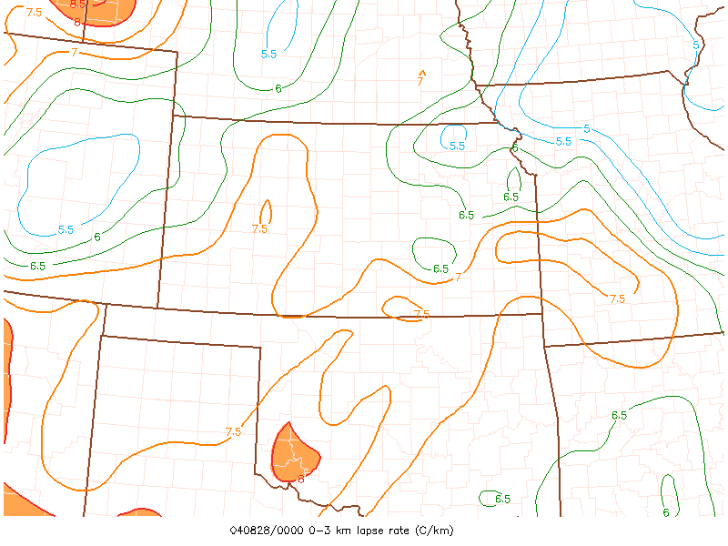

Slide 43
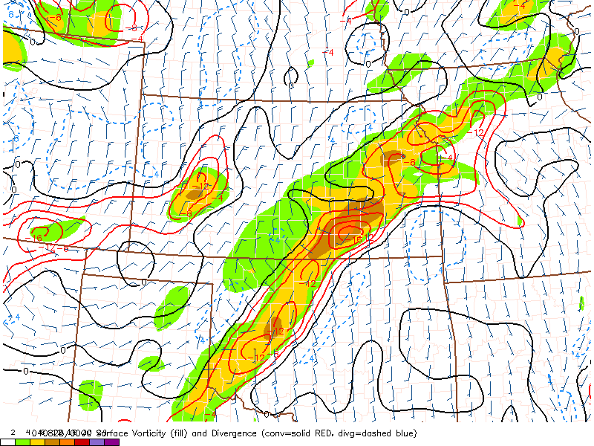

Slide 44
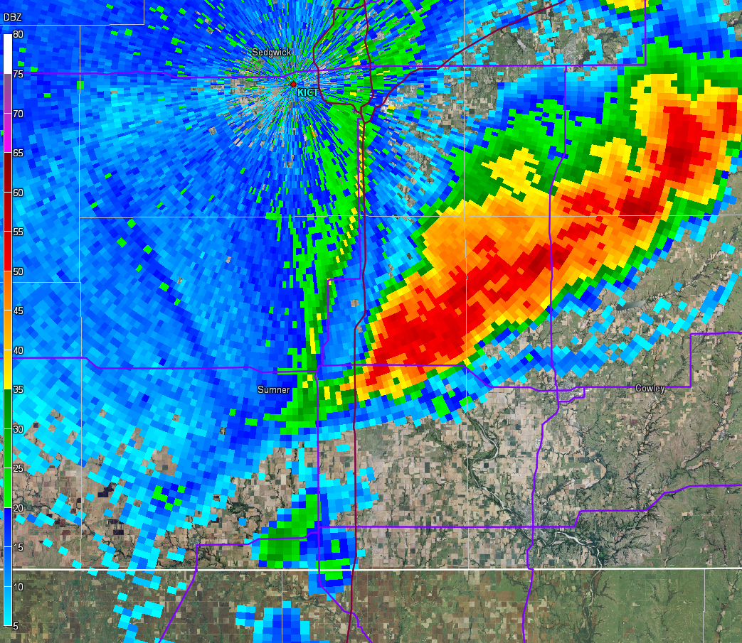

Slide 45
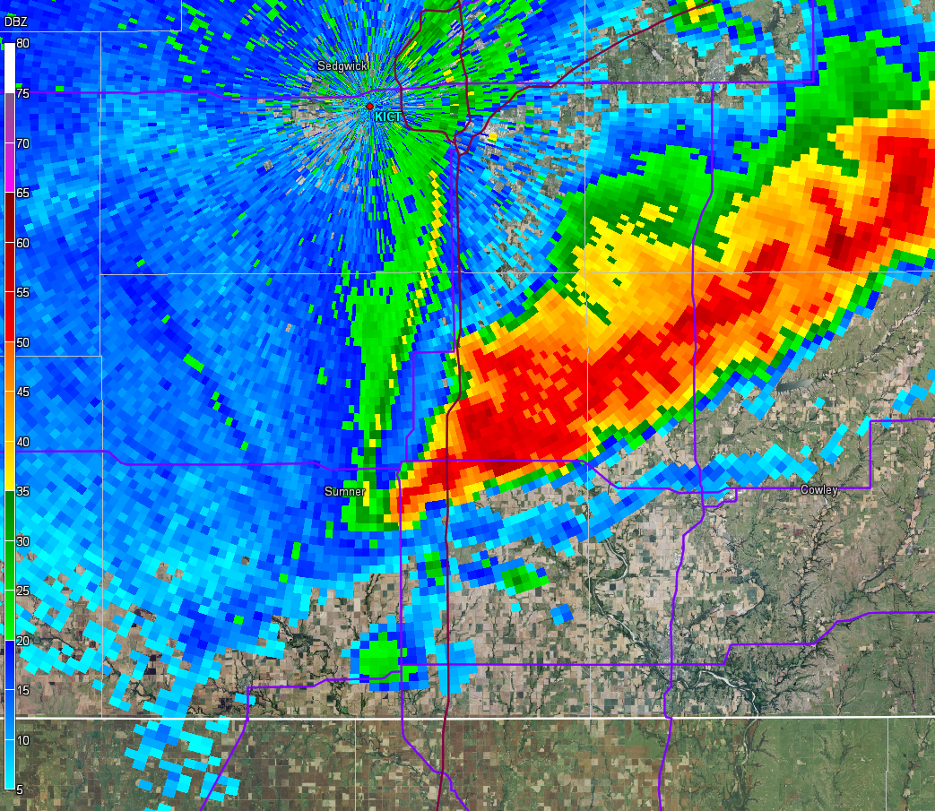

Slide 46
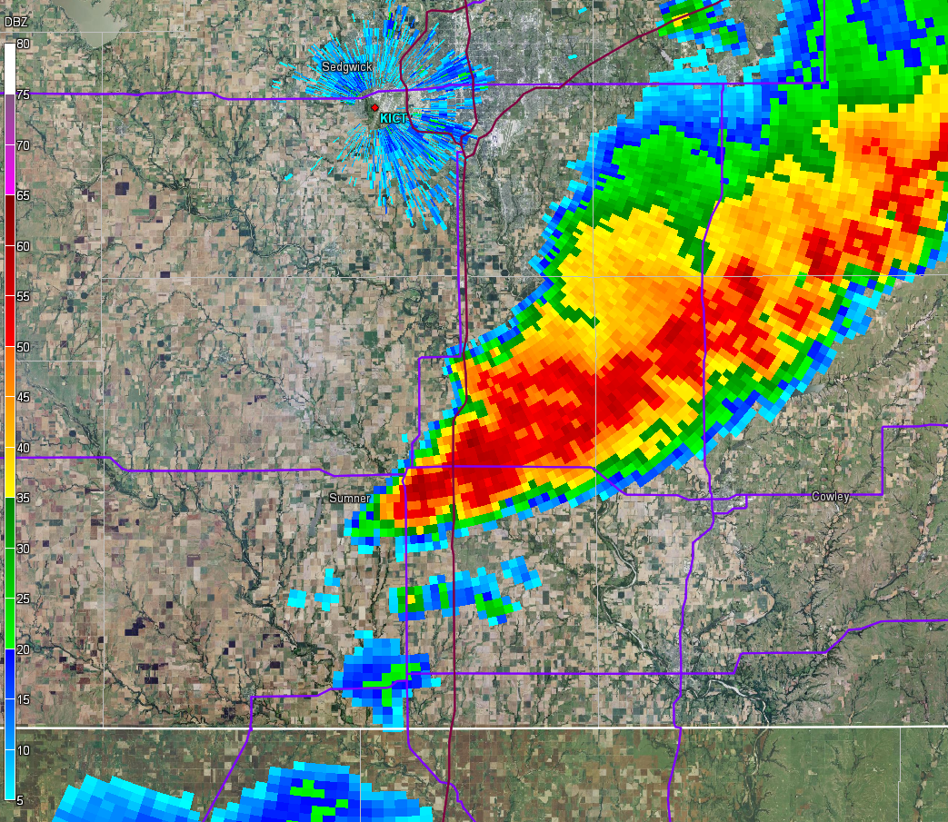

Slide 47
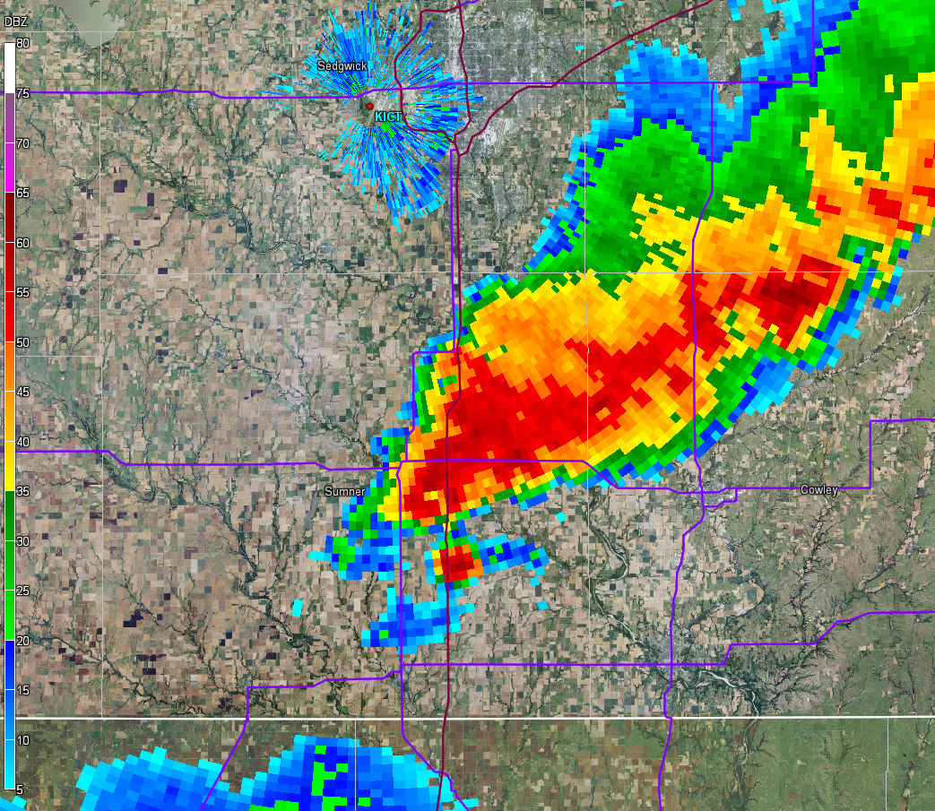

Slide 48
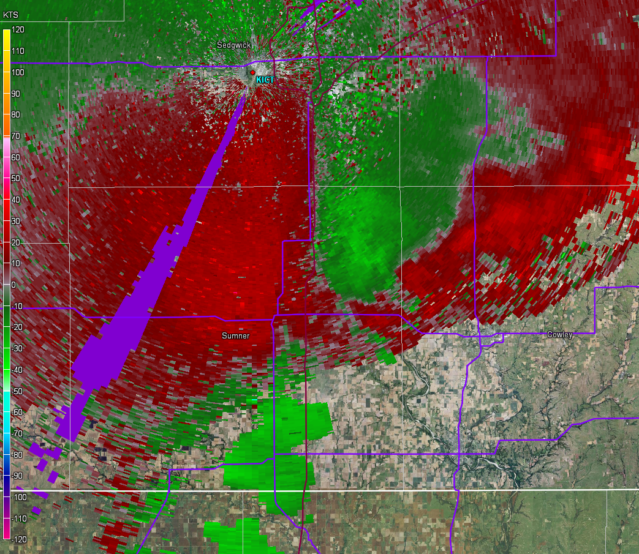

Slide 49
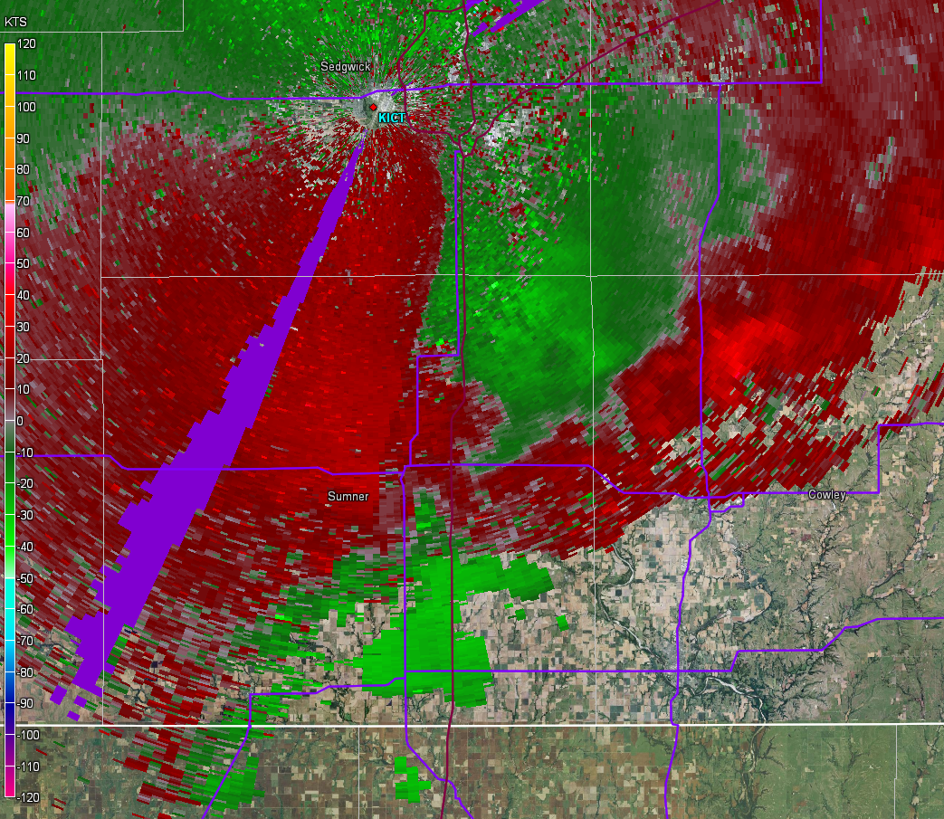

Slide 50
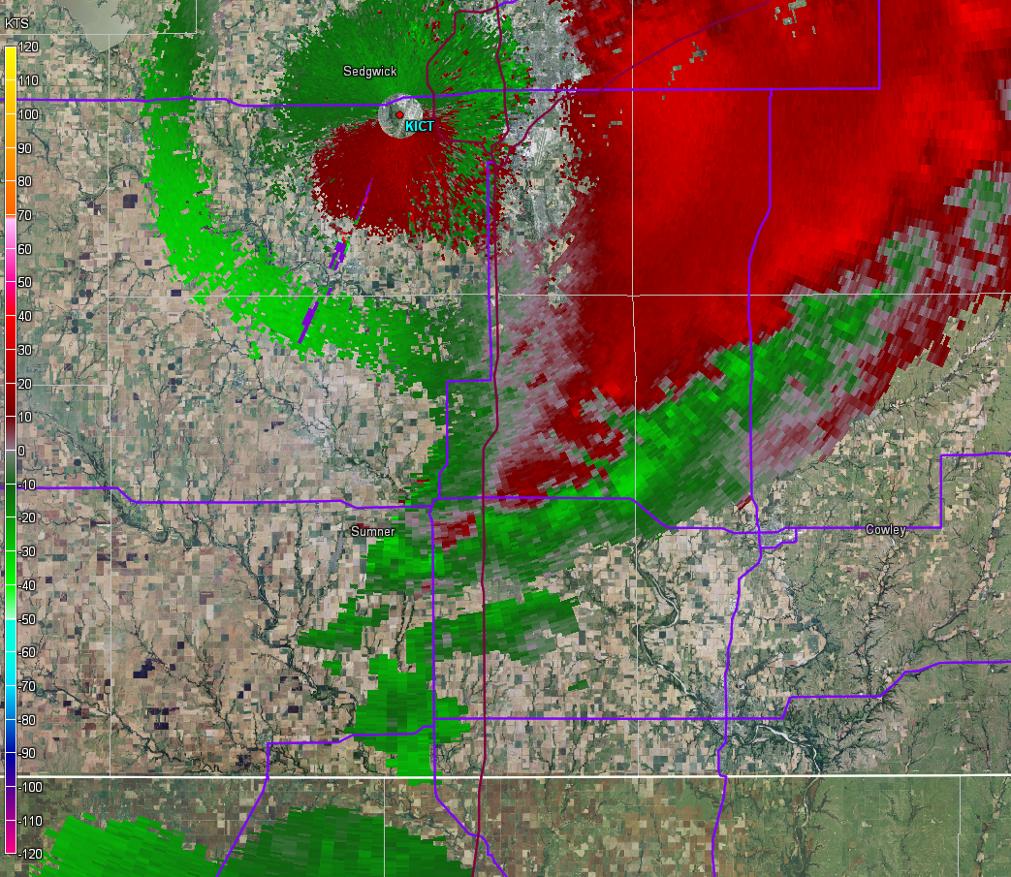

Slide 51
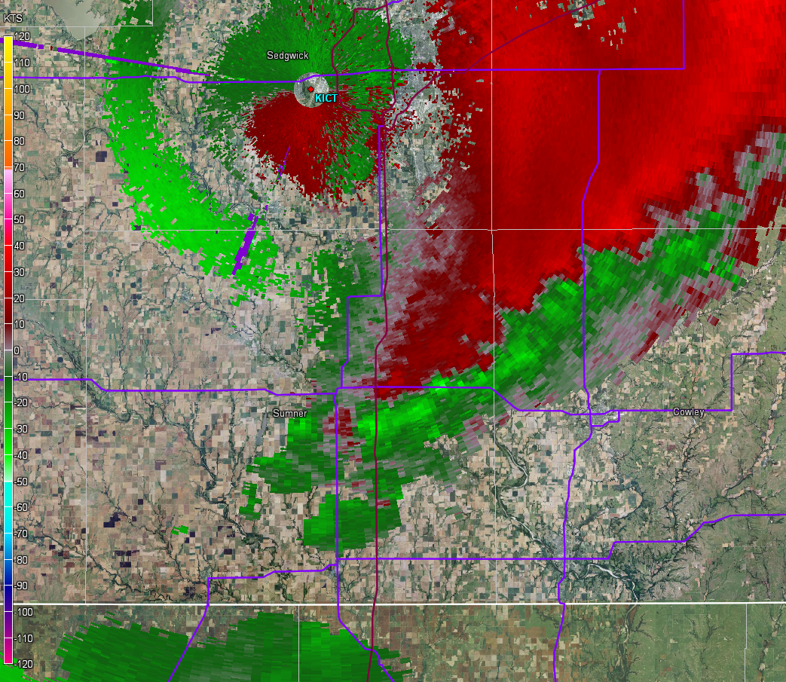

Slide 52
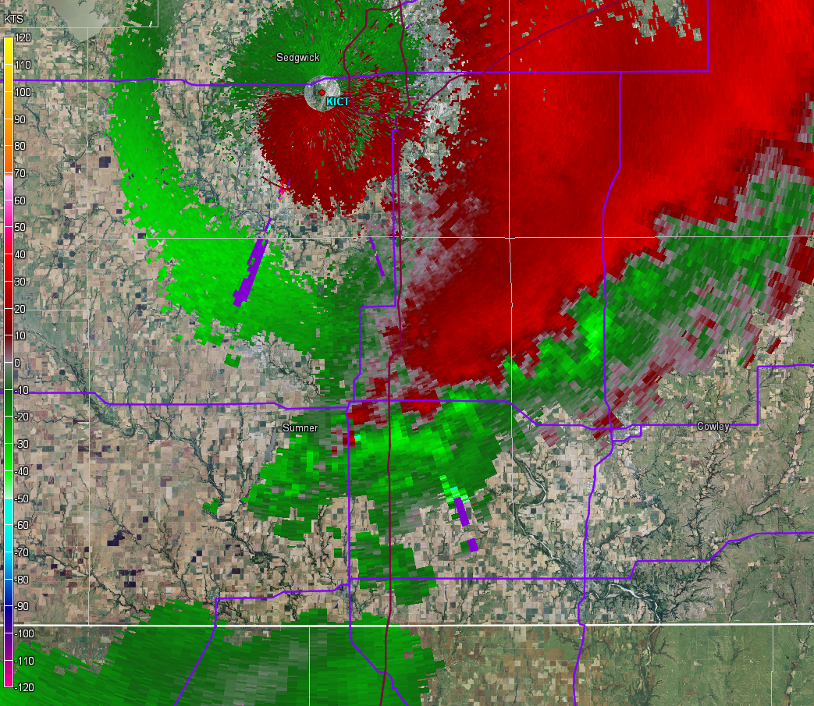

Slide 53
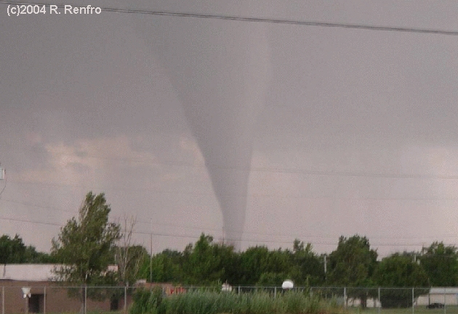

Slide 54
Limiting Factors
Too stable at the ground
  Cold outflow disrupts low-level stretching
Storms can move off boundary before amplifying swirlies into tornadoes

Slide 55

Mesocyclonic Tornadoes

Slide 56
Vorticity sources
Recall “right hand” rule – vorticity vector in the direction of your right thumb
SRH – think of “vortex tubes” that the storm tilts and stretches into rotation aloft
“Baroclinic” vorticity – generated along storm gust fronts (related to frontogenesis)

Slide 57
Mesocyclonic Tornadogenesis
Persistent, rotating updraft
  Buoyancy and environmental vertical shear
  Pressure perturbation gradients induce “suck” factor with mesocyclones
    Lower pressure aloft with strongest rotation, which draws low-level air upward (stretching source)
What is the source for near-surface rotation in a supercell?

Slide 58

Tilting by an updraft alone cannot produce vertical vorticity at the surface—air is rising away from the surface as the vorticity vector acquires a vertical component. Davies-Jones (1982)
Herb Stein
Courtesy of Dr. Paul Markowski PSU

Slide 59
Source for near-surface rotation
Is NOT environmental horizontal vorticity (SRH)
  Tilting and stretching results in rotation aloft
Observations and numerical simulations suggest source for surface rotation is within the RFD

Slide 60





A downdraft appears to be essential for the development of near-surface rotation.
not too cold and strong suction from above
too cold and/or weak suction from above
Courtesy of Dr. Paul Markowski PSU

Slide 61
What about “not too cold” and “strong suction from above”?
Almost never have direct measurements of either quantity
However, can infer both from environment and remotely sensed data

Slide 62







How to Make a Tornado—The Emerging Picture?
wind shear
streamwise vorticity
downdraft
Courtesy of Dr. Paul Markowski PSU
Photo by Eric Nguyen

Slide 63
Strong suction from above
“Suction” related to mesocyclone strength aloft
Stronger mesocyclone closer to the ground leads to stronger “suction” and stretching closer to the ground

Slide 64
What do we observe?
Strengthening of midlevel rotation
Surface pressure falls when we happen to have observations
Strengthening near-surface inflow
Laminar cloud structures indicative of forced ascent (if relatively stable in low levels)

Slide 65

SRV ~65 kt @3kft

Slide 66

SRV ~82 kt @3kft

Slide 67

V_{rot} ~58 kt @20kft

Slide 68

V_{rot} ~70 kt @20kft

Slide 69


Slide 70


Slide 71


Slide 72


Slide 73
“Not too cold”
Even though the low-level updraft is mostly due to air being drawn upward beneath the midlevel mesocyclone, the resistance to ascent is still important
Air feeding near-surface mesocylone originates within RFD
  If it’s cold and stable (little CAPE and large CIN), will be difficult to amplify vorticity
  If it’s warm and unstable (large CAPE and little CIN), vorticity will amplify quickly through stretching

Slide 74




Low-level buoyancy fields of supercells intercepted in VORTEX1
adapted from Markowski et al. (2002)
tornadic
16 May 1995 (Burdett, KS)
2 June 1995 (Dimmitt, TX)
nontornadic
29 April 1995 (Sherman, TX) 12 May 1995 (Hays, KS)
Paradox: Though baroclinic vorticity generation is crucial, excessively cold downdrafts and outflow appear to be detrimental to tornadogenesis!
not too cold and strong suction from above
Courtesy of Dr. Paul Markowski PSU

Slide 75
Forward trajectories through low-level mesocyclone in tornadic supercell intercepted by VORTEX2 (5 June 2009)
Forward trajectories through low-level mesocyclone in nontornadic supercell intercepted by ROTATE (12 June 2004)
A downdraft—and baroclinic vorticity generation experienced by air parcels during their descent—appear to be essential for the development of near-surface rotation.
Though the development of near-surface rotation is a prerequisite for tornadogenesis, it is insufficient for tornadogenesis—the near-surface mesocyclone-strength rotation must be amplified to tornado strength (by roughly a factor of 100) via stretching.
Markowski et al. (2011)
not too cold and strong suction from above
Courtesy of Dr. Paul Markowski PSU

Slide 76
What is the role of environmental horizontal vorticity?
L
L
not too cold and strong suction from above
too cold and/or
weak suction from above
Courtesy of Dr. Paul Markowski PSU

Slide 77
More “not too cold”
Don’t have direct thermodynamic observations throughout supercell/RFD
What corresponds to “not too cold” in the environment?
  Higher LCL (lower RH) means more potential evaporation/cooling, and less buoyant RFD
  Lower LCL (higher RH) means less potential evaporation/cooling, and more buoyant RFD

Slide 78
Positive feedback
Buoyancy and vertical shear support supercells (persistent, rotating updraft)
Low pressure aloft strengthens as mesocyclone strengthens
Strengthening mesocyclone aloft leads to forced low-level ascent and stronger storm inflow
If air in RFD is not too cold/stable, then low-level stretching is enhanced
Can amplify storm-generated vertical vorticity to a tornado

Slide 79

2. Low-level updraft/meso
(forward flank )
3. Tornado
(rear flank)
1. Deep updraft/meso
(warm sector)

Slide 80

Three Basic Ideas
1. Will ambient environment support a right-moving supercell?
2. Will forward-flank inflow support amplification of low-level mesocyclone?
3. Will RFD air be stretched and vertical vorticity amplified rapidly?

Slide 81
The Meteorology of Tornado
Forecasting:
Supercell and Tornado Parameters
Rich Thompson
SPC

Slide 82
Recall supercell necessities…
An initial updraft (buoyancy)…
Vertical wind shear…
Updraft tilts and stretches horizontal vorticity (generated by ambient vertical shear)
  Leads to mesocyclone development, which makes for a stronger, longer-lived storm

Slide 83
How are these concepts applied?
Buoyancy is readily calculated (CAPE)
Vertical wind shear – through what depth?
  Need sufficient horizontal vorticity
    Low-level shear (rotation)
  Also need sufficient vertical shear so that developing precipitation is removed from updraft
    Deep-layer shear (longevity)

Slide 84
What do we mean by “low-level” shear?
“Low-level shear” meant to represent storm inflow layer
  Horizontal vorticity only matters if it corresponds to potential buoyancy
Effective inflow layer
  Contiguous layer of lifted parcels meeting CAPE and CIN constraints
  Empirical (100 J kg⁻¹ CAPE and 250 J kg⁻¹CIN)

Slide 85

Effective Inflow Layer

Slide 86


Slide 87


Slide 88


Slide 89


Slide 90


Slide 91


Slide 92


Slide 93
Apply effective inflow layer to hodograph
“effective SRH”

Slide 94



Slide 95
What do we mean by “deep-layer” shear?
“Deep-layer shear” meant to represent storm depth
  Must look high enough to consider forming precipitation
  Sustained supercells in simulations when shear extended through at least 5-6 km AGL

Slide 96
How do we account for storm depth?
Effective bulk wind difference
  Consider depth of CAPE-bearing layer and storm inflow
  % depth from inflow base to MU parcel EL

Slide 97

Effective Bulk Wind Difference

Slide 98

BWD by % of storm depth
(surface-based storms)
Stronger BWD with non-supercell storms (top “whisker”)
Weaker BWD with supercell storms (bottom “whisker”)

Slide 99
Effective Bulk Wind Difference (EBWD)
Very similar to 0-6 km bulk wind difference in “typical” cases
More flexible uses than fixed-layer bulk wind differences (such as 0-6 km)
  Designed to represent shallow and deep buoyancy environments
  Designed to represent elevated thunderstorm environments

Slide 100
Increasing supercell risk

Slide 101

Right-Moving Supercells

Slide 102
Supercell Composite Parameter (SCP)
Combine measures of buoyancy and vertical wind shear relevant to supercell formation
Normalize terms to climatological distributions
Non-linear product of normalized terms allows CAPE and vertical shear to “compensate” for one another

Slide 103

Stronger updrafts

Slide 104
Effective-layer SCP
SCP = ( MUCAPE / 1000 J kg⁻¹ )
X
( EBWD / 20 m s⁻¹ )
X
( ESRH / 50 m² s⁻² )

Slide 105
Right-moving Supercells > 2
Non-supercells < 2

Slide 106

Weaker rotation – smaller SCP
Stronger rotation – larger SCP

Slide 107
SCP weaknesses
Conditional – CI not considered explicitly
  Convective mode also not considered
Sensitive to storm motion estimate
  Putting “cart before the horse”?

Slide 108
SCP strengths
Simple estimate of conditional supercell potential
Covers wide range of environments (surface-based and elevated storms)
Physical basis in relevant processes

Slide 109

Significant Tornadoes

Slide 110
Significant Tornado Parameter (STP)
Use same approach as in SCP, specific to mesocylonic tornado production
  Deep-layer vertical shear, buoyancy, and convective inhibition
    Right-moving supercell formation and longevity
  Focus on buoyancy, convective inhibition, and vertical shear rooted near the ground
    Estimate potential for strong mesocylone and induced low-level stretching
  Estimate potential for evaporative cooling in RFD
    Resistance to low-level stretching

Slide 111

ESRH – driving factor
Increasing tornado risk

Slide 112

MLCAPE – driving factor
Stronger updrafts

Slide 113

EBWD – driving factor
Increasing supercell risk

Slide 114

MLLCL – limiting factor
Decreasing tornado risk

Slide 115

MLCIN – limiting factor
Decreasing tornado risk

Slide 116
Effective-layer STP
STP = ( MLCAPE / 1500 J kg⁻¹ )
X
( EBWD / 20 m s⁻¹ )
X
( ESRH / 150 m² s⁻² )
X
( (2000 – MLLCL) / 1000 m)
X
( (200 + MLCIN) / 150 J kg-1)

Slide 117

Sigtor supercells > 1
Nontor supercells < 1

Slide 118
Rationale behind STP
Identify sustained supercell environments
  MLCAPE, MLCIN, and EBWD
Identify strong low-level stretching potential
  ESRH combined with sustained supercell
Estimate resistance to stretching within RFD
  MLCAPE, MLCIN, and MLLCL
Strong tornadoes more probable where all conditions are met

Slide 119
STP weaknesses
Conditional – based on existence of supercell
Simplified estimate of environments favoring both supercell initiation and sustenance
  Initiation and storm demise are different problems!
RFD character is (likely) more complicated than just evaporation potential
  Microphysical characteristics of precipitation!
No direct way to consistently measure or estimate vorticity generation within the RFD

Slide 120

What’s up next?

